Slide 1
Indigenous People
Aseda and David o

Slide 2
Tuesday 9th November 2021
Oli: To explain how humans function in the places they live

Slide 3
Evenk People

Slide 4
Evenki are a fishing, hunting and reindeer herding people that occupy East Siberia, Far East of Russia, Northern China and Mongolia. It is estimated that approximately 36,000 Evenki live today and 7,000 speak the language.
l

Slide 5
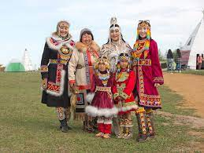
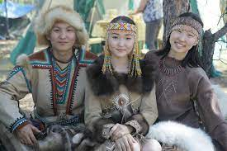
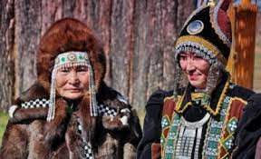
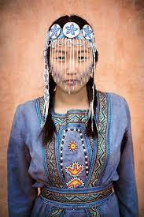
Evenks Clothing:
For winter clothing, the Evenks used fur, dressed deer skin, (and later cloth). As a rule the main material that was ‘provided’ by deers , sometimes elks

Slide 6
Evenks language:
Evenki is a Northern Tungusic language spoken mainly in northern China, and also in Russia and Mongolia. In China Evenki was spoken by about 11,000 in 2007 in Inner Mongolia.

Slide 7

Evenks flag:

Slide 8
AFL: My way of life is similar because we have people that hunt for our foods.
SA:
Www – I can find interesting facts about the Evenks.

