Slide 1
Reading for Pleasure
Accelerated
Reader

Slide 2
Reading for Pleasure: A Guide for Parents
In KS2 all students take part in the Accelerated Reader programme, which is designed to do the following things:
Find books that are the right ability for your child
Encourage your child to read more
Improve your child’s reading ability.

Slide 3

How it works…
At the start of the term every student took a Star Test, which is a computer-based test that measures a student’s reading ability through a series of 34 questions.
Every test for every student is different, and the computer selects different questions for each student dependent on how well they answer the previous questions. Essentially, the computer adapts the test to suit your son or daughter.
Once the student has completed the test, they are then given a ZPD score (Zone of Proximal Development) by their teacher.
Notes:
https://ukhosted62.renlearn.co.uk/1892677/default.aspx If they can’t find it

Slide 4

How STAR tests work
The student must take their time. It is recommended that each child should spend at least 20 minutes on their tests. Students are used to working quickly in timed conditions, but during a STAR test it is about concentration, focus and careful reading.
Students should not guess answers to questions. Instead, they should wait for the question to time out. This is to ensure the computer is not given a false impression of the student’s reading ability.
Tests are done in exam conditions without any help from other students or the teacher.

Slide 5
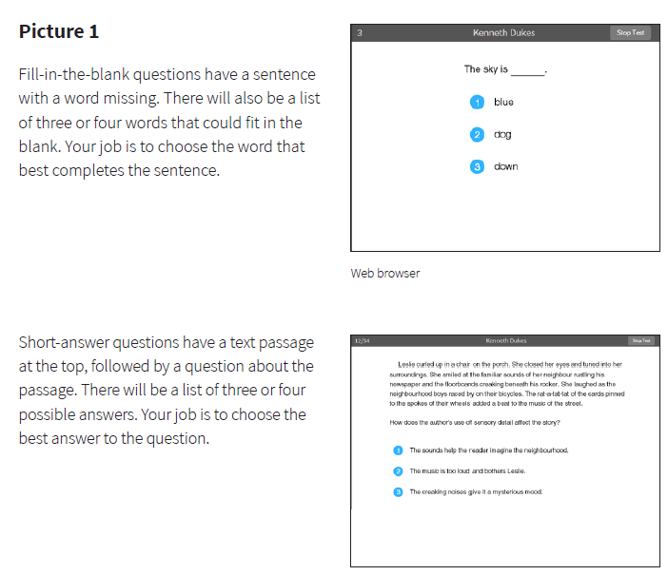

Slide 6

A ZPD score is given to your child after completing the STAR test
3.2 – 4.6
Lowest number
Highest number
ZPD is two numbers that the student uses to choose their next reading book.
The lowest number is the lowest level of book the student should be choosing.
The highest number is the highest level of book the student should be choosing.
Students keep a record of all their ZPDs in their reading records.
A new STAR test takes place every half term, so students can see improvements in their reading ability, but also choose more challenging books.

Slide 7

Quizzes
A quiz is different to a STAR test because students only take a quiz after they have finished a whole book.
There are arrange of questions on the book that has been read. At the end of the quiz the students are given a score to show them how well they have done.
There are some important rules for taking quizzes:
The book the child is quizzed on must the most recent book they have been reading in school. AR is not a memory test but rather measuring reading ability.
A student cannot take a quiz until they have read the entire text.
Quizzes must be done individually, not with anyone’s help.

Slide 8

How it works Overview
https://www.youtube.com/watch?v=FuU7GC6QZTE

Slide 9
Reading for Pleasure at All Saints
In Key Stage 2 there is a daily 30 min ‘Reading for Pleasure’ designated slot
During this time identified pupils will be reading 1:1 with an adult
Rest of the class are quiet reading and quizzing
The computer can tell teachers very specific information about your child’s reading development. For instance, it can even explain how many minutes a day your child is reading

Slide 10

“How much should my child read each day?”
According to Renaissance Learning’s research, children who read at least 20 minutes a day with a 90% comprehension rate on AR quizzes see the greatest gains.
Therefore, your child should have at least 20 minutes set aside for reading during day.

Slide 11
“How can I help?”
As with anything, performance improves with practice.
Encourage your child to read at home.
Create a culture of reading in your household by reading with your child, starting a home library, visiting your local library, charity shop or bookshop on a regular basis and by letting your child see you reading.
When reading with your child stop and ask questions to be sure your child comprehends what they have read and in general make a habit of discussing books that each of you has read.

Slide 12
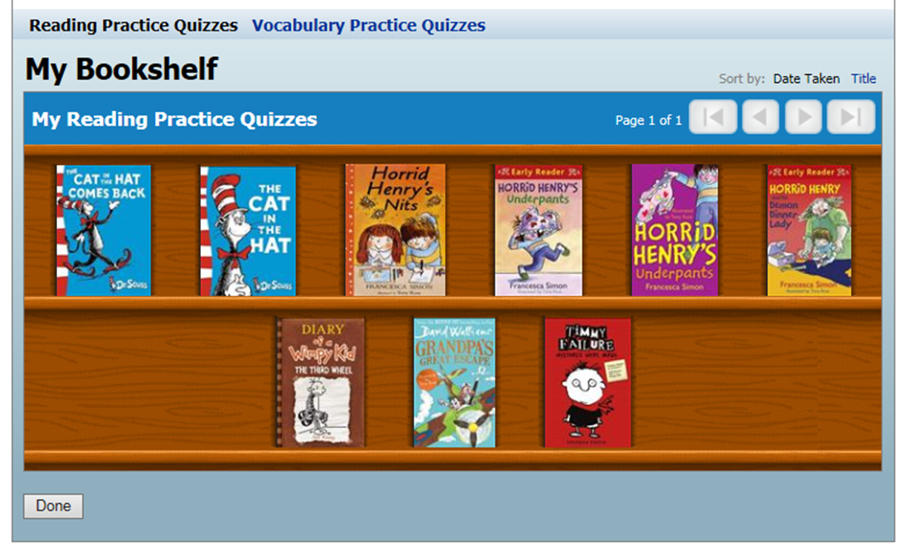
How will I know how my child is doing?
Your child can access their account at home with their individual login details.
Once in the programme, your child will be able to show you their progress, targets and bookshelf.

Slide 13
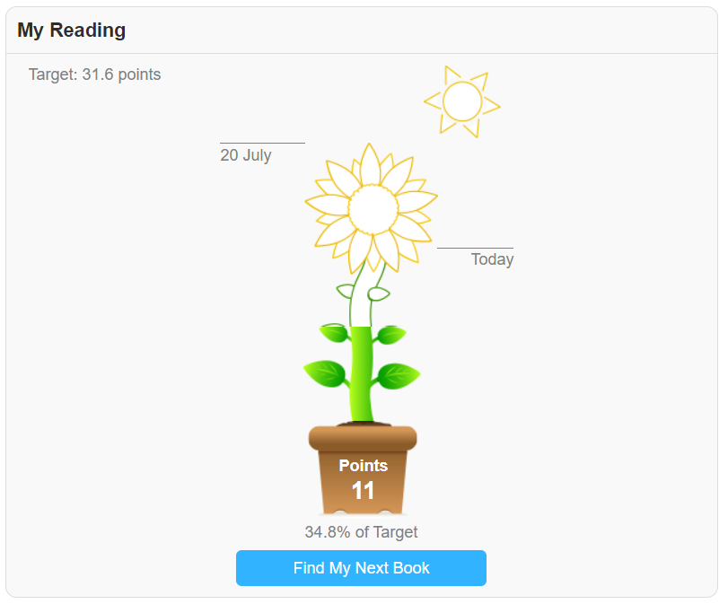
How will I know how my child is doing?
KS1 children see this when they look at their progress in the dashboard.
Target
Points earned
Progress towards target

Slide 14
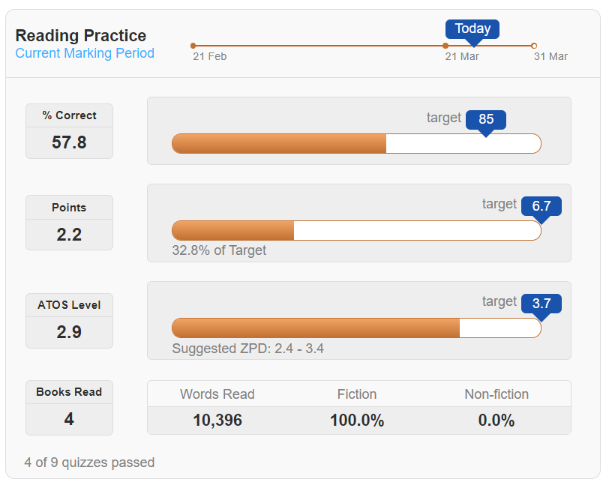
How will I know how my child is doing?
KS2 children see this when they look at their progress in the dashboard.
% average of questions correct
Progress to target
Average book level read

Slide 15
ARBookFind.co.uk
It’s not just books from school that children can read, they can read books from home and take quizzes on them!
You can use ARBookFind.co.uk to check whether your child’s current book is on Accelerated Reader.
Try to make sure the book they are reading is within their ZPD
Children can’t quiz after 3:30 so will need to quiz in school.

Slide 16
Any Questions ?

