Slide 1


Phonics Screening
Year 1
A guide for parents.

Slide 2
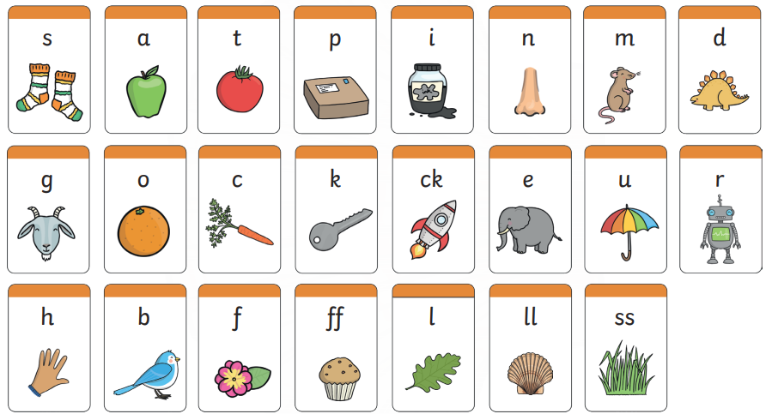
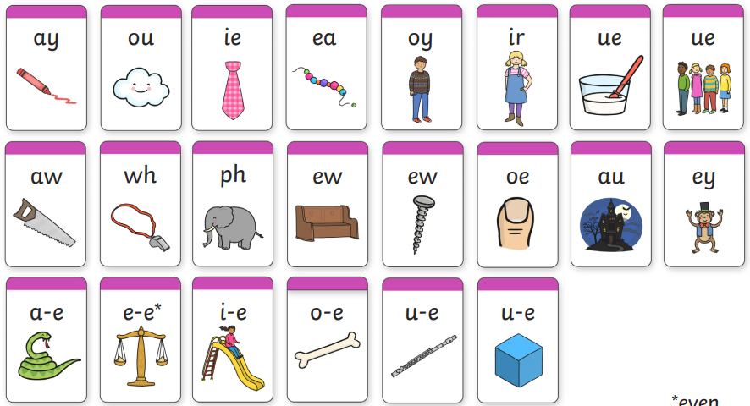
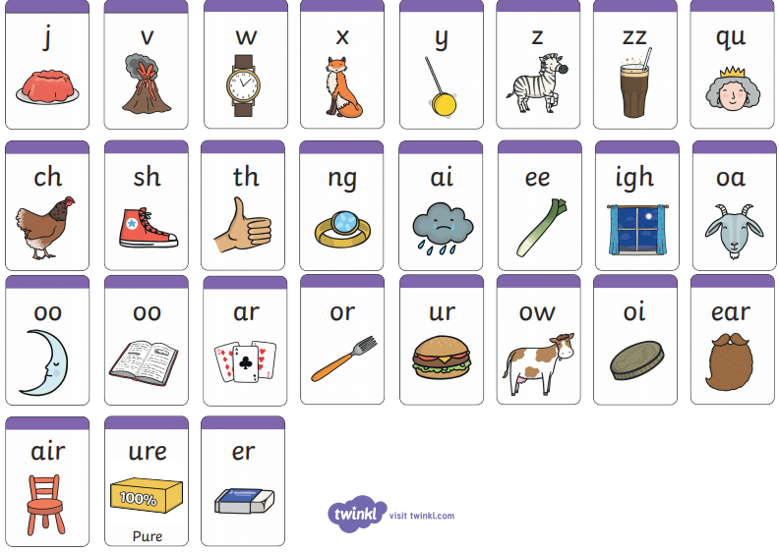
What is Phonics?
Children are taught to read by breaking down (segmenting) words into separate sounds or ‘phonemes’. They are then taught how to blend these sounds together to read the whole word.
Children in Key Stage 1 have a RWI phonics lesson daily and they are encouraged to use these strategies to read and write in other lessons.

Slide 3
Reading changes everything
Teach a child to read and keep that child reading and we will change everything.
And I mean everything.
Jeanette Winterson
3
Notes:
Read quote.
By the end of Year 1, we want all of our children to be able to read accurately – to read both familiar and unfamiliar words - so that they can go on to become a fluent, enthusiastic reader.
The Phonics Screening Check in June in year 1 is a word reading test to check children can read sounds in words accurately.
Accurate word reading at 6 is a predictor of future success.

Slide 4
What is the Phonics Screening Check?
A word-reading test at the end of Year 1.
Children read 40 words.
Notes:
Children complete the phonics screening check at the end of Year 1 so that parents can be confident their children are being taught to read successfully.
Children read 40 words. It takes between two and five minutes.
If they do not manage to read 32 of the words successfully, they are given extra support, and repeat the check at the end of Year 2.
It means that all children will be able to read accurately before they begin Year 3.

Slide 5
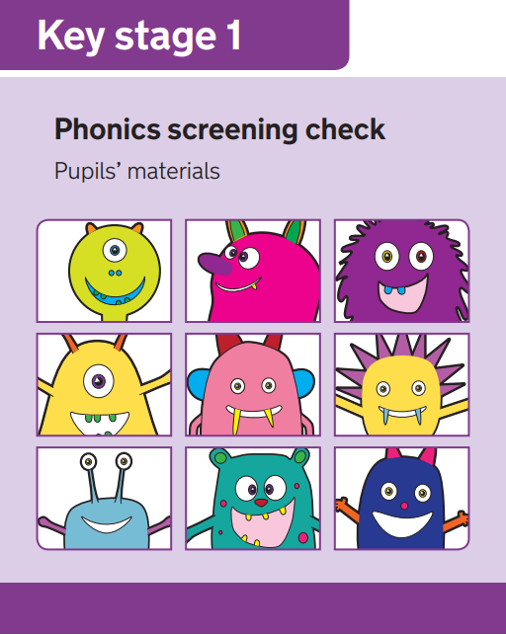
What is the aim of the check?
The Phonics Screening Check is designed to confirm whether individual children have learnt phonic decoding (i.e. apply their knowledge of letter-sound relationships) and blending (i.e. the skill of joining individual speech sounds (phonemes) together to make a word) skills to an appropriate standard

Slide 6
Speed Sounds Set 3
7
Notes:
Children learn all of the sounds on this chart.
Once they know all of these sounds, they will be able to read any unfamiliar word.

Slide 7

When will the screening happen?
Every Year 1 child in the country will be taking the Phonics Screening Check in June.
Those Year 2 children who don’t pass will be talking the test.
The results will be reported to parents.

Slide 8
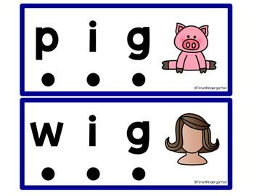
What do we expect children to do?
The check is very similar to tasks the children already complete during phonics lessons
Children will be asked to ‘sound out’ (Fred Talk) a word and blend the sounds together, eg d-o-g - dog
The focus of the check is to see which sounds the children know
THIS IS NOT A READING TEST

Slide 9
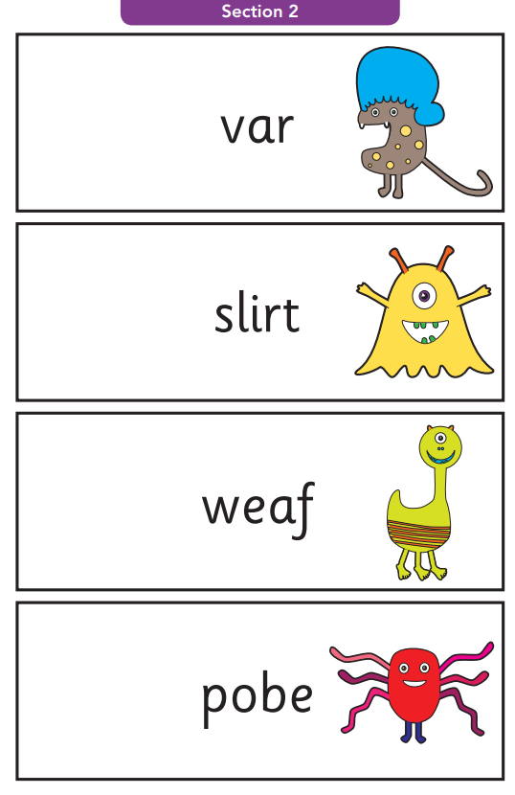
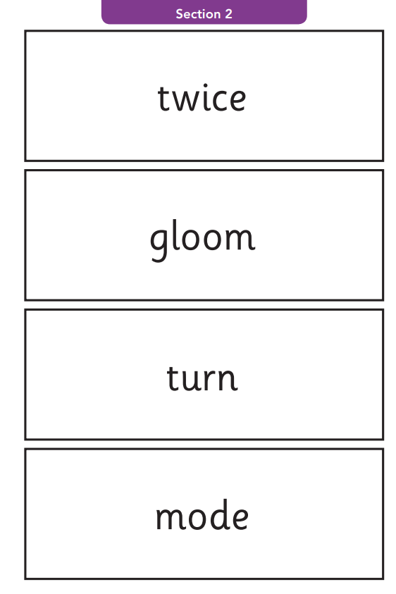
Example words
Alien/Pseudo words
Real words

Slide 10

How will the children complete the check?
The children will complete the check one at a time in a quiet area of the school.
The screening will only take 5-10 mins with each child.

Slide 11
How can you help?
The way in which you learnt to read, is probably very different from the way we teach children to read now, so here is a quick guide to some of the things you can do to help you child in preparation for the Screening Check.
Help your child to use ‘Special Friends’, ‘Fred Talk’ to read words.
Encourage children to use sound buttons when breaking the words down if necessary.
  A dot for a single phoneme, a small line for a digraph/trigraph and a hook for an split digraphs we called these special friends. These should all be placed under the letters in the word
Watch the virtual RWI classroom films together on the school website.
Listen to your child read everyday!

Slide 12

Using sound buttons
We use sound buttons to help children recognise the different parts of a word. (single phonemes, digraphs, trigraphs and split digraphs)

Slide 13


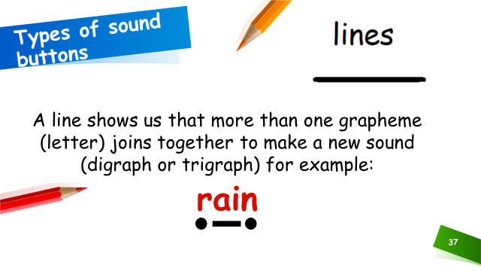
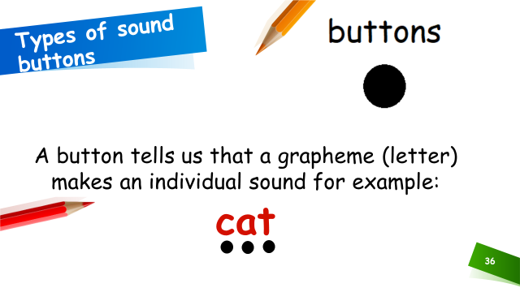
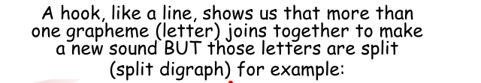

Using sound buttons

Slide 14

‘Special Friends’, ‘Fred Talk’
14
Notes:
We teach children to words using the routine ‘Special Friends’, ‘Fred Talk’, read the word’.
Children spot the ‘Special Friends’ (two letters that make one sound), Fred talk the word, and then read the whole word.
For example, ‘sh’, sh-i-p, ship.

Slide 15
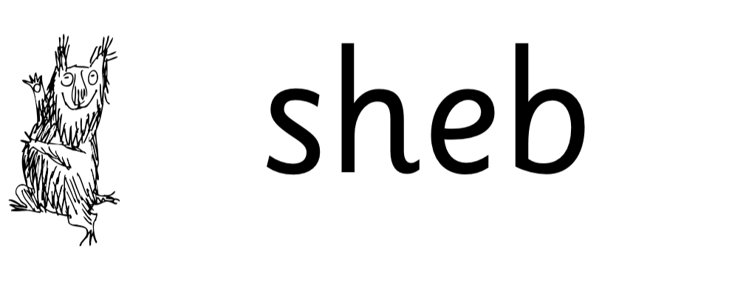
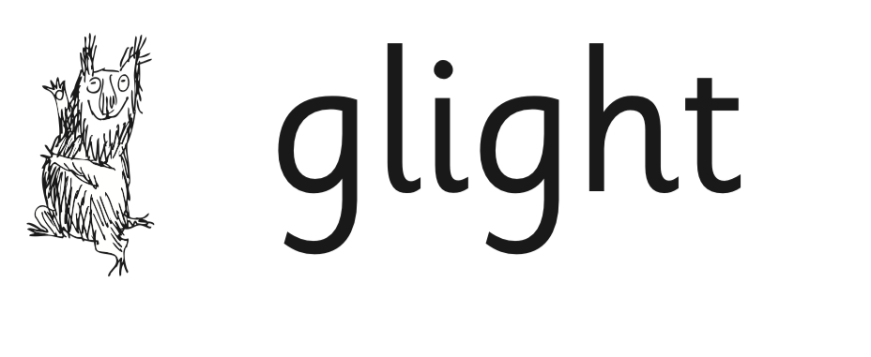


Nonsense words
15
Notes:
Half of the words in the check are real words.
Half are nonsense words. For example, ‘sheb’, ‘glight’, ‘ched’, ‘teb’.
There is a picture of an alien next to each word to remind the children that it isn’t a real word.
Nonsense words are used to assess children’s reading.
They check that children will be able to read sounds the sounds they know in unfamiliar words.
They read these words using the same routine as real words – ‘Special Friends, Fred Talk.’
Children who can read nonsense words will, very soon, be able to read any new word – for example – gargantuan, flailing, raucous, anticipation;
Reading new words increases children’s vocabulary rapidly.

Slide 16
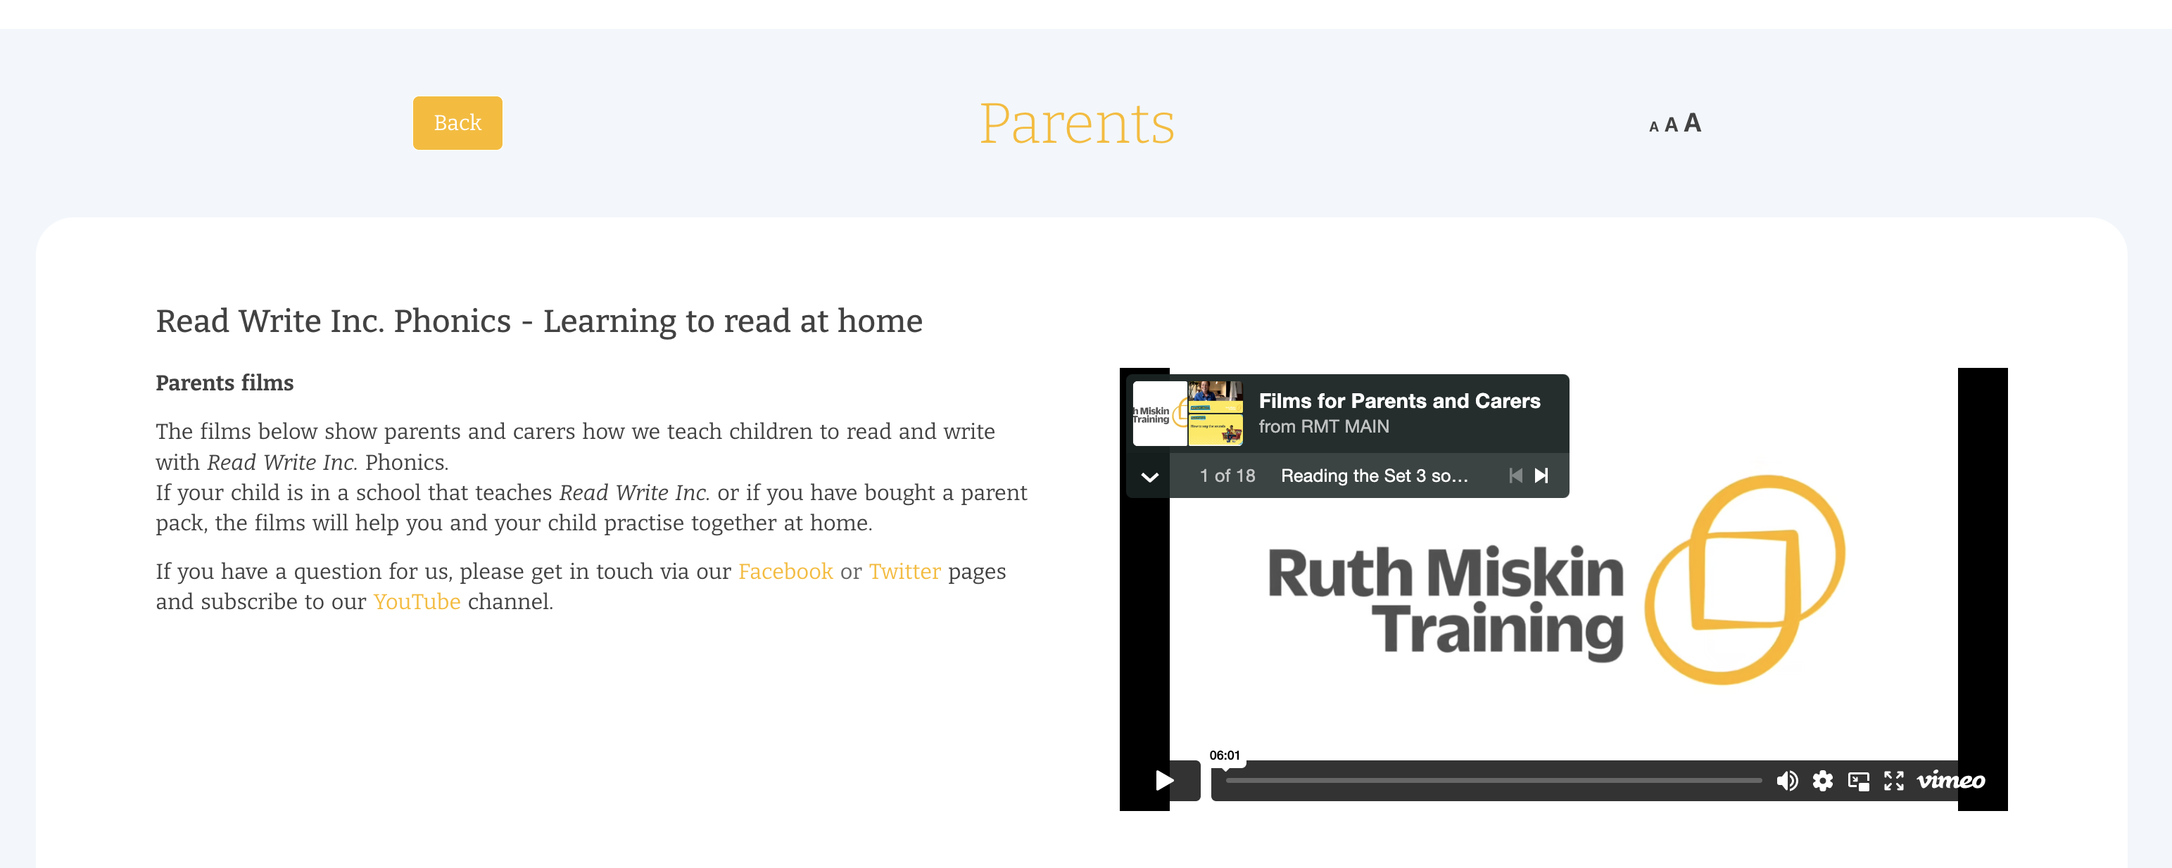
Free Video Tutorials (ruthmiskin.com)
16
Notes:
Watch these video tutorials on the Ruth Miskin website to find out more about the PSC:
Understanding Phonics
The Phonics Screening Check

Slide 17
Online resources available
Ruth Miskin Parents’ Page:
https://www.ruthmiskin.com/parents/
Ruth Miskin Facebook:
https://www.facebook.com/miskin.education
Free e-books for home reading:
http://www.oxfordowl.co.uk/Reading/
17

Slide 18
Questions
If you have any questions regarding the Phonics Screening Check, please contact the school office and arrange an appointment with your child’s class teacher, myself or a member of SLT.

Slide 19

Thank you
Thank you for your ongoing support

