Slide 1
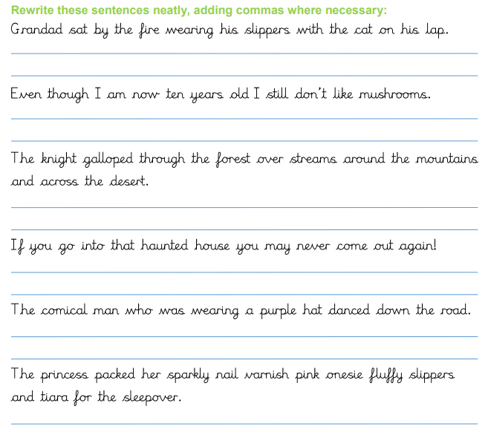

Literacy
Tuesday 8th September 2026
HWP

Slide 2
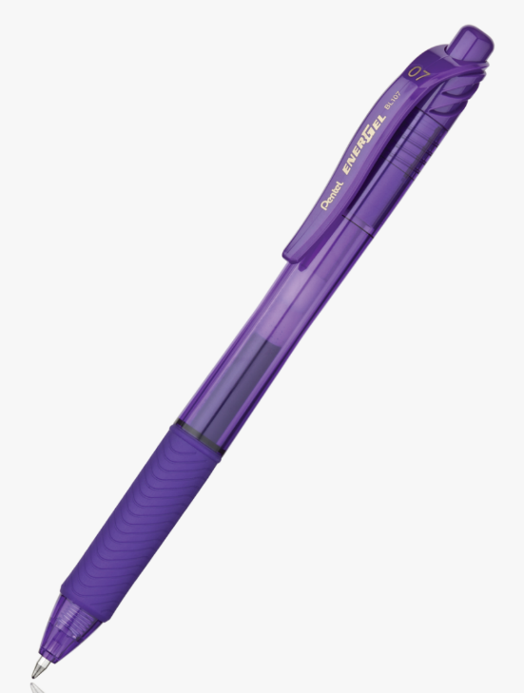
Literacy Tuesday 8th September 2026
OLI: DROP EVERYTHING AND WRITE: To write a short story.
OSCI:
I can use a variety of conjunctions.
I can use fronted adverbials.
I can use expanded noun phrases
I can build suspense within my writing
RTM:
Write the sentence below and write its word class beneath it.
The happy, old woman rested in her rocking chair as the sun smiled down upon her.

Slide 3
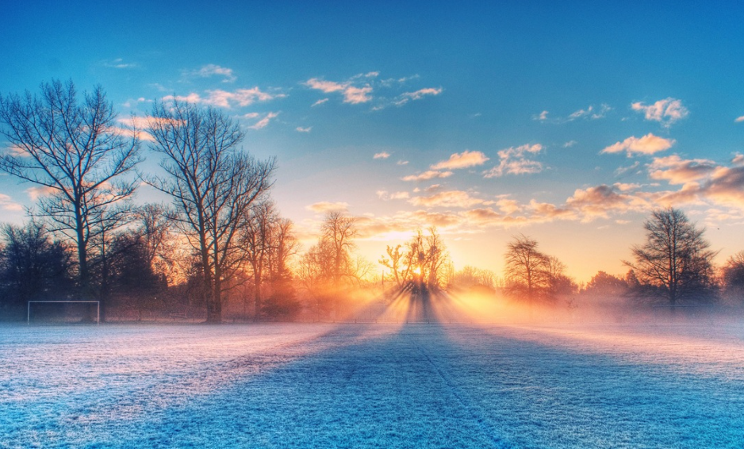

Slide 4
I had been walking for hours, not realising that with every step I took, my legs became more and more tired. Despite the winter sun shining down on me, the air was crisp and I longed for the extra pair of gloves that I had forgotten on the kitchen side that morning. Being forgetful was my downfall and I hoped that this wouldn’t hinder my adventure. For months I had planned my journey in secret, not even telling my best friend – which was the hardest part of it all. ‘An explorer is not a job for a young girl, go to school, read some books!’ My dad would say, never truly understanding my love for the world and everything in it. I wanted to explore. I had waited for too long. My adventure was finally beginning and I couldn’t be more excited.
The trees stretched their arms above me, creating shadows, which were dancing around me. The blanket of snow glistened in the sun and crunched beneath my feet as I walked. In my pocket, I held my compass tightly in the palm of my hand, excited for what was to come. Beginning to feel exhausted, I sat down for a moment on the log of a tree, which had been cut down, and slowly slipped my tea. Suddenly, I heard the familiar voice of someone. I thought I was alone…
Activity one:
Write down some phrases that you can magpie.
Can you identify the fronted adverbials using a highlighter?

Slide 5
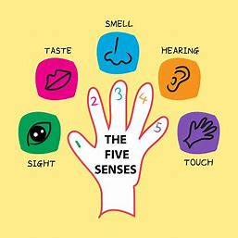
ACTIVITY: Continue the story. You are a young girl, who is desperate to be an explorer. It is finally the day of your new adventure and you have managed to keep it secret for months. You are on your way when all of a sudden, you hear a familiar voice…
Whilst writing, consider the five senses to describe how you were feeling.
Challenge: Can you use ‘Show, don’t tell’?

Slide 6

AFL: Highlight the features found in activity one, within your own piece of writing.
What is your favourite sentence from your work today? Why?
I have been shining at …….
I can use a variety of conjunctions. ​
I can use fronted adverbials.​
I can use expanded noun phrases​
I can build suspense within my writing
SA:
I can ARISE further by …….

