Slide 1
Maths Recap 8.9.26
You are going to be completing a maths quiz

Slide 2
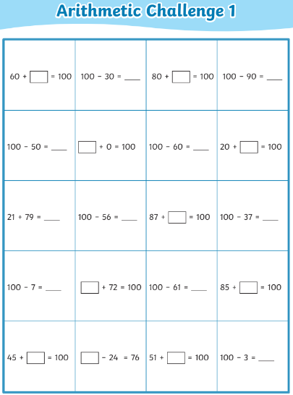

Slide 3
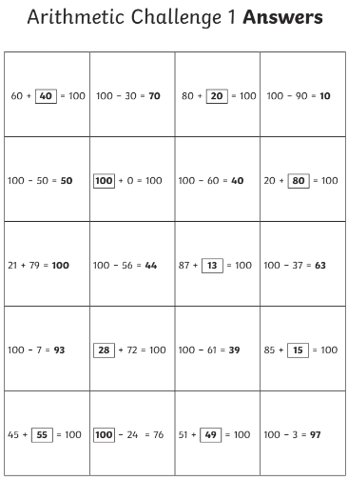
Mark your work

Slide 4
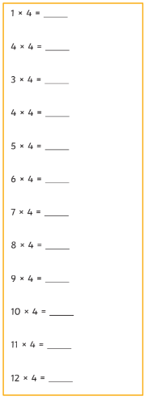
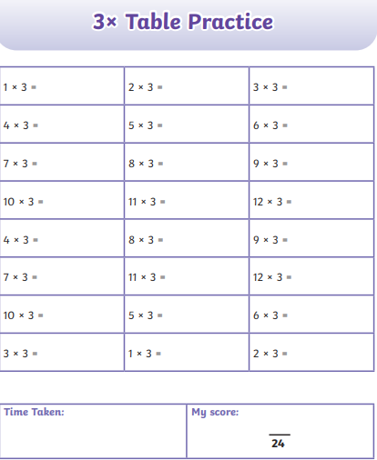
Practice your times tables
https://www.topmarks.co.uk/maths-games/hit-the-button

Slide 5
Spellings

Slide 6
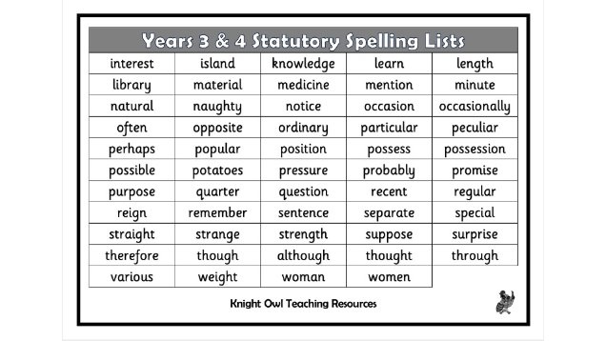
Choose five spellings to practice
CC
Write sentences with the words you chose

Slide 7
Art

Slide 8
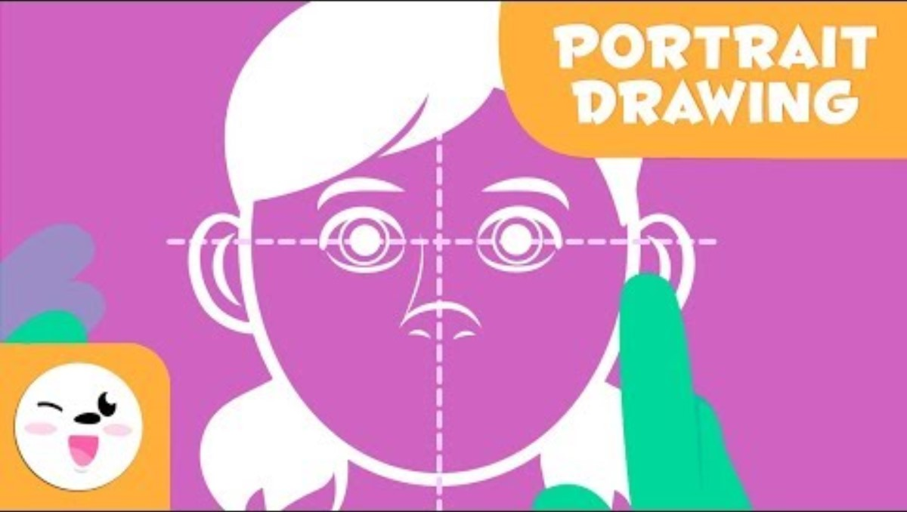
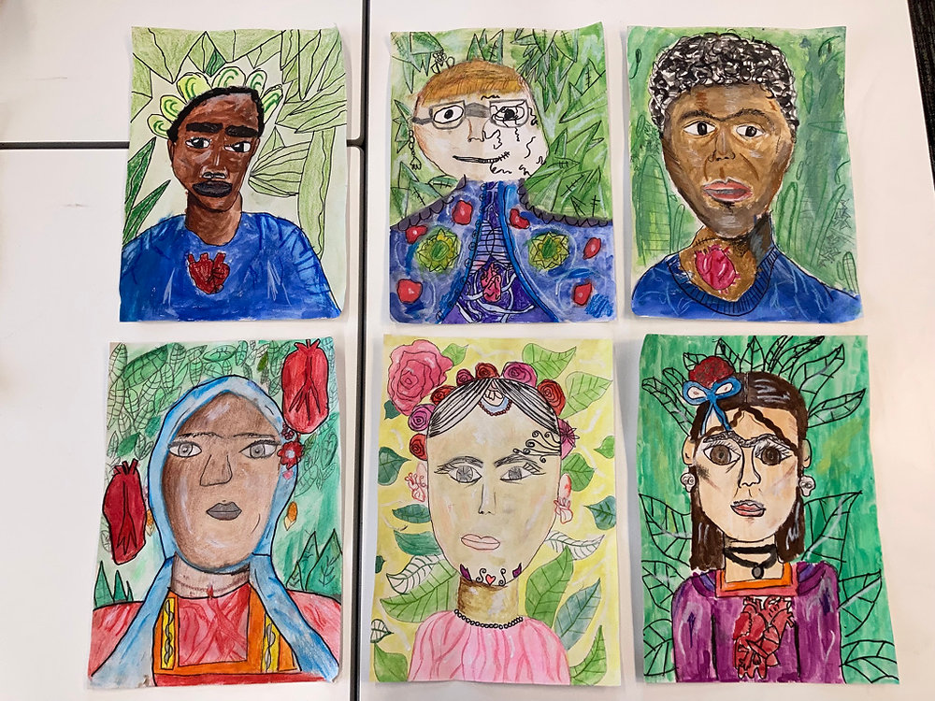
Portraits
Draw a self-portrait
If you have a mirror, use this to help you.
Here are some examples.

Slide 9

I have been shining at …….
I can ARISE further by …….

