Slide 1
Tuesday- Home Learning

Slide 2
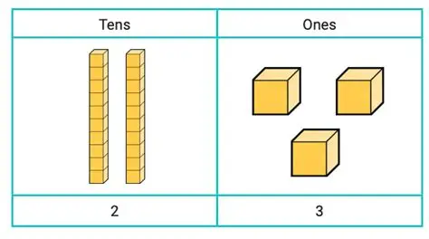
Maths
We are learning about place value and understanding tens and ones.
Number hunt: choose 5 numbers between 0 and 20. Can you find objects around your home to represent each number? You could use Lego, pasta, buttons, toys or anything you have available.
For each number, can you say how many tens and ones it has?
For example: 14= 1 ten and 4 ones.
Cheeky Challenge: Can you make your own number clues for someone at home to solve?

Slide 3
Topic- Childhood
We are learning about childhood and how it has changed over time.
Talk to a parent, grandparent or another family member about what childhood was like when they were young.
Can you find out:
What toys did they play with?
What games did they play?
What did they watch on television?
What was school like?
What was their favourite thing to do?
Challenge: draw a picture of something they enjoyed during their childhood.

Slide 4
Literacy- Autobiographies
We are beginning to learn about autobiographies.
Create a simple autobiography about yourself. You could include:
Your name
Your age
Where you live
Who is in your family
Your favourite things
Something you enjoy doing

Slide 5
Wednesday- Home Learning

Slide 6
Math's- Place Value
Ask an adult to give you some numbers between 0 and 20.
For each number:
Say the number
Show it using objects
Tell someone how many tens and ones it has
Write the numb
Cheeky Challenge: Can you find different ways to make the same number?

Slide 7
Literacy- All about me
Continue your autobiography by writing 3-5 sentences about yourself.
You could write about:
Your favourite food.
Your favourite toy
Your favourite animal
Your favourite place
What you would like to be when you grow up.
Remember to use capital letters, finger spaces and full stops.

Slide 8
Topic- Then and Now
Think about what you have learnt about childhood in the past.
Choose one thing, such as toys, games, school or television.
Draw what it was like then and what it is like now.
Have fun and I can’t wait to see your fantastic home learning!

