Slide 1
08/09/2026
OLI: To count forwards and backwards accurately from 20 to 50.
RTM
Count from 0-20
OSCI:
I can count forwards from 20 to 50.
I can count backwards from 50 to 20.
I can spot when a number is missing or incorrect.

Slide 2
Let’s Get Warmed Up…
Complete the questions.
Find the missing number.
2. Circle the correct missing number for the calculation 13 - = 8.
3. Can you make your own missing number question with the answer 15? How many can you find?
4 | + | ? | = | 9
4
5
9
6
? | + | ? | = | 15
? | - | ? | = | 15

Slide 3
Let’s Get Warmed Up…
Complete the questions.
Find the missing number.
2. Circle the correct missing number for the calculation 13 - = 8.
3. Can you make your own missing number question with the answer 15? How many can you find? Various answers, for example:
4 | + | 5 | = | 9
4
5
9
6
8 | + | 7 | = | 15
19 | - | 4 | = | 15

Slide 4
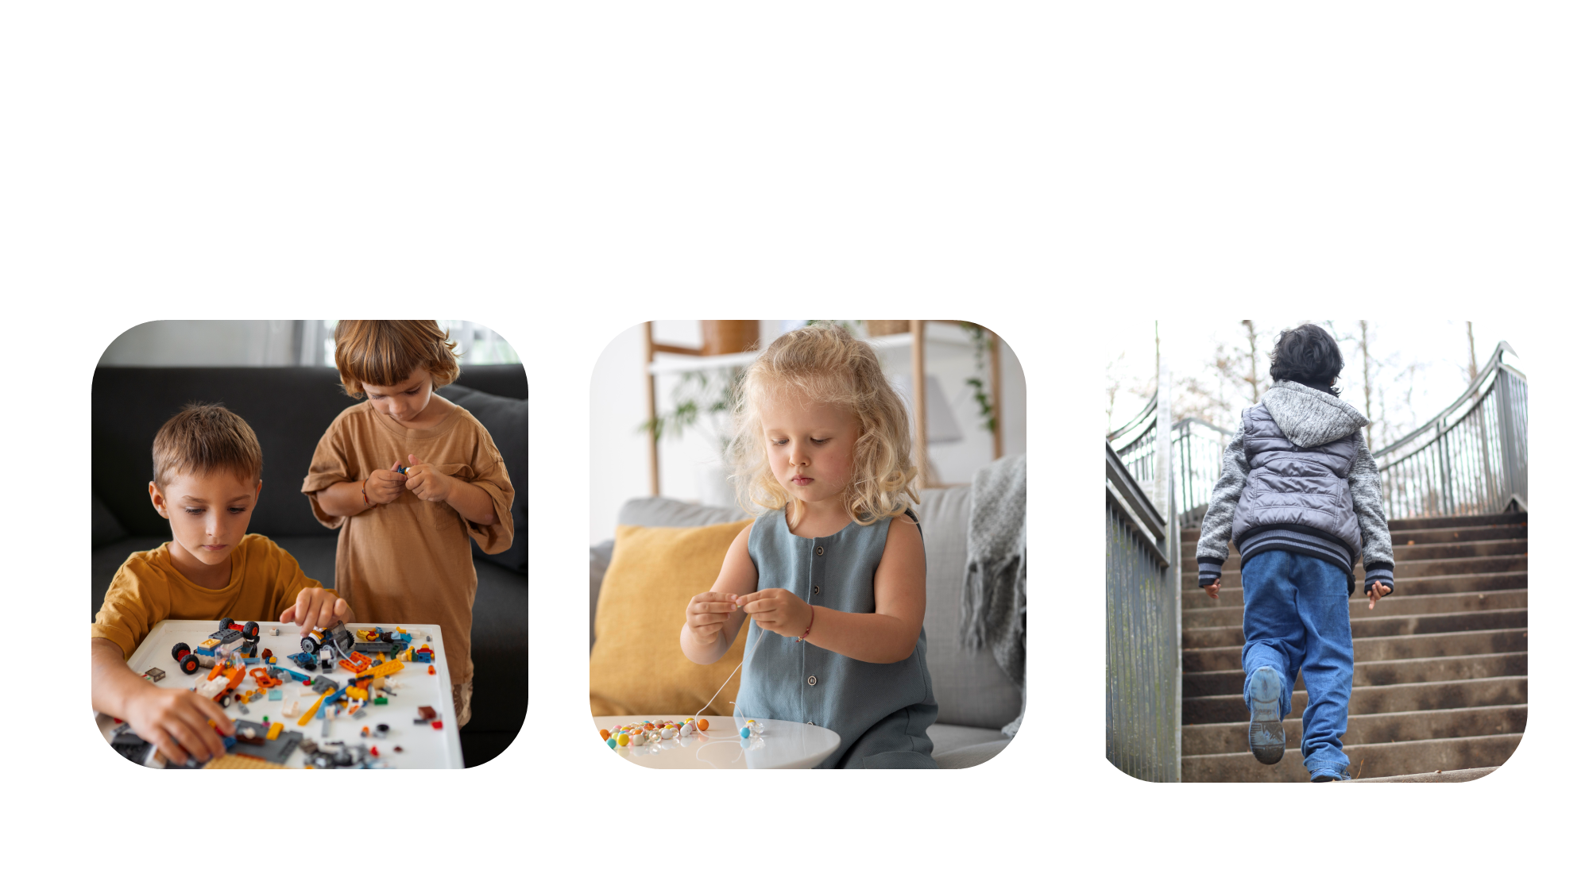
Maths in the Real World
Counting from 20 to 50 helps us find out how many we have and what comes next. We can count:
building bricks
beads on a string
steps

Slide 5
Let’s Learn…
Let’s practise counting forwards from 20 to 50 out loud.
1 | 2 | 3 | 4 | 5 | 6 | 7 | 8 | 9 | 10
11 | 12 | 13 | 14 | 15 | 16 | 17 | 18 | 19 | 20
21 | 22 | 23 | 24 | 25 | 26 | 27 | 28 | 29 | 30
31 | 32 | 33 | 34 | 35 | 36 | 37 | 38 | 39 | 40
41 | 42 | 43 | 44 | 45 | 46 | 47 | 48 | 49 | 50

Slide 6
Let’s Learn…
We can now count forwards from any number.
The number that comes after 39 is 40.
1 | 2 | 3 | 4 | 5 | 6 | 7 | 8 | 9 | 10
11 | 12 | 13 | 14 | 15 | 16 | 17 | 18 | 19 | 20
21 | 22 | 23 | 24 | 25 | 26 | 27 | 28 | 29 | 30
31 | 32 | 33 | 34 | 35 | 36 | 37 | 38 | 39 | 40
41 | 42 | 43 | 44 | 45 | 46 | 47 | 48 | 49 | 50
2 + 8 = 10

Slide 7
Let’s Learn…
We can now count forwards from any number.
The number that comes after 24 is 25.
1 | 2 | 3 | 4 | 5 | 6 | 7 | 8 | 9 | 10
11 | 12 | 13 | 14 | 15 | 16 | 17 | 18 | 19 | 20
21 | 22 | 23 | 24 | 25 | 26 | 27 | 28 | 29 | 30
31 | 32 | 33 | 34 | 35 | 36 | 37 | 38 | 39 | 40
41 | 42 | 43 | 44 | 45 | 46 | 47 | 48 | 49 | 50
2 + 8 = 10

Slide 8
Let’s Practise…
1 | 2 | 3 | 4 | 5 | 6 | 7 | 8 | 9 | 10
11 | 12 | 13 | 14 | 15 | 16 | 17 | 18 | 19 | 20
21 | 22 | 23 | 24 | 25 | 26 | 27 | 28 | 29 | 30
31 | 32 | 33 | 34 | 35 | 36 | 37 | 38 | 39 | 40
41 | 42 | 43 | 44 | 45 | 46 | 47 | 48 | 49 | 50
The number that comes after 42 is ______ .
2 + 8 = 10

Slide 9
Let’s Practise…
1 | 2 | 3 | 4 | 5 | 6 | 7 | 8 | 9 | 10
11 | 12 | 13 | 14 | 15 | 16 | 17 | 18 | 19 | 20
21 | 22 | 23 | 24 | 25 | 26 | 27 | 28 | 29 | 30
31 | 32 | 33 | 34 | 35 | 36 | 37 | 38 | 39 | 40
41 | 42 | 43 | 44 | 45 | 46 | 47 | 48 | 49 | 50
43
The number that comes after 42 is ______ .
2 + 8 = 10

Slide 10
Let’s Learn…
Let’s practise counting backwards from 50 to 20 out loud.
1 | 2 | 3 | 4 | 5 | 6 | 7 | 8 | 9 | 10
11 | 12 | 13 | 14 | 15 | 16 | 17 | 18 | 19 | 20
21 | 22 | 23 | 24 | 25 | 26 | 27 | 28 | 29 | 30
31 | 32 | 33 | 34 | 35 | 36 | 37 | 38 | 39 | 40
41 | 42 | 43 | 44 | 45 | 46 | 47 | 48 | 49 | 50

Slide 11
Let’s Learn…
We can now count backwards from any number.
The number that comes before 31 is 30.
1 | 2 | 3 | 4 | 5 | 6 | 7 | 8 | 9 | 10
11 | 12 | 13 | 14 | 15 | 16 | 17 | 18 | 19 | 20
21 | 22 | 23 | 24 | 25 | 26 | 27 | 28 | 29 | 30
31 | 32 | 33 | 34 | 35 | 36 | 37 | 38 | 39 | 40
41 | 42 | 43 | 44 | 45 | 46 | 47 | 48 | 49 | 50
2 + 8 = 10

Slide 12
Let’s Practise…
1 | 2 | 3 | 4 | 5 | 6 | 7 | 8 | 9 | 10
11 | 12 | 13 | 14 | 15 | 16 | 17 | 18 | 19 | 20
21 | 22 | 23 | 24 | 25 | 26 | 27 | 28 | 29 | 30
31 | 32 | 33 | 34 | 35 | 36 | 37 | 38 | 39 | 40
41 | 42 | 43 | 44 | 45 | 46 | 47 | 48 | 49 | 50
The number that comes before 28 is ______ .
2 + 8 = 10

Slide 13
Let’s Practise…
1 | 2 | 3 | 4 | 5 | 6 | 7 | 8 | 9 | 10
11 | 12 | 13 | 14 | 15 | 16 | 17 | 18 | 19 | 20
21 | 22 | 23 | 24 | 25 | 26 | 27 | 28 | 29 | 30
31 | 32 | 33 | 34 | 35 | 36 | 37 | 38 | 39 | 40
41 | 42 | 43 | 44 | 45 | 46 | 47 | 48 | 49 | 50
27
The number that comes before 28 is ______ .
2 + 8 = 10

Slide 14
Let’s Learn…
We can use the number track to find numbers that come before or after another number.
31 | 32 | 33 | 34 | 35
The number that comes before 33 is 32.
The number that comes after 33 is 34.

Slide 15
Let’s Practise…
Use the number track to complete these sentences.
38 | 39 | 40 | 41 | 42
The number that comes before 39 is ______ .
The number that comes after 41 is ______ .

Slide 16
Let’s Practise…
Use the number track to complete these sentences.
38 | 39 | 40 | 41 | 42
38
The number that comes before 39 is ______ .
42
The number that comes after 41 is ______ .

Slide 17
Let’s Learn…
We can use number tracks to identify missing numbers.
This number track is counting backwards as the numbers are getting smaller.
49 | 48 |  | 46 | 45 |  | 43 |  | 41 | 40
47
44
42

Slide 18
Let’s Learn…
We can use number tracks to identify missing numbers.
This number track is counting forwards as the numbers are getting bigger.
33 |  | 31 | 30 |  | 28 | 27 | 26 |  | 24
32
29
25

Slide 19
Let’s Practise…
Complete the number tracks. Say the numbers out loud.
20 |  |  | 23 | 24 |  | 26 |  |  | 29
A.
42 |  | 40 |  |  | 37 | 36 |  | 34
B.
28 |  |  |  | 32 |  | 34 | 35 |  | 37
C.

Slide 20
Let’s Practise…
Complete the number tracks. Say the numbers out loud.
20 | 21 | 22 | 23 | 24 | 25 | 26 | 27 | 28 | 29
A.
42 | 41 | 40 | 39 | 38 | 37 | 36 | 35 | 34 | 33
B.
28 | 29 | 30 | 31 | 32 | 33 | 34 | 35 | 36 | 37
C.

Slide 21
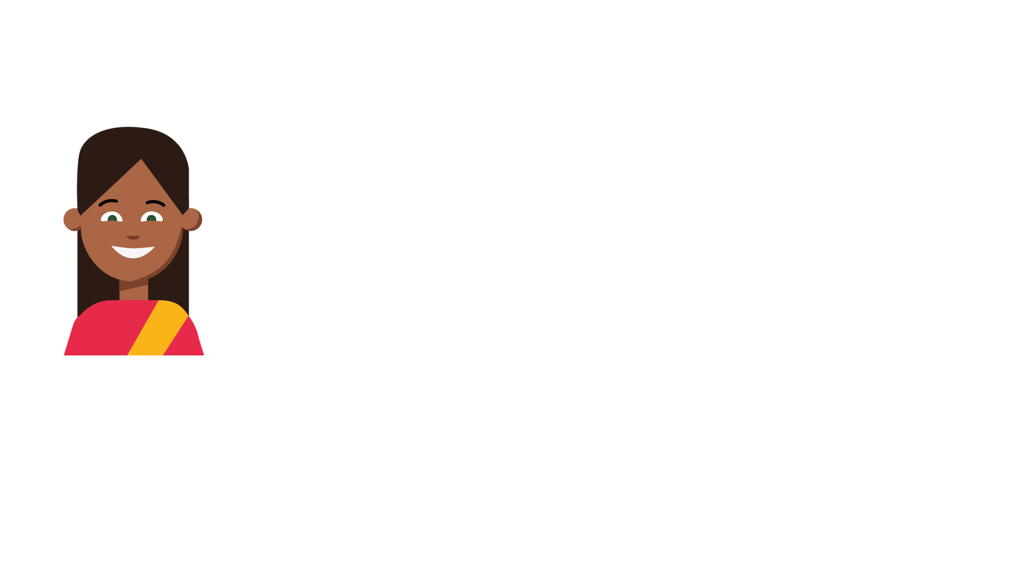
Let’s Reason…
Rashana is counting backwards.
Is Rashana correct? Explain why.
Rashana is correct/incorrect because...
43, 42, 14, 40, 39

Slide 22
Let’s Reason…
Rashana is counting backwards.
Is Rashana correct? Explain why.
Rashana is incorrect because she has written 14 instead of 41. Rashana has reversed the digits.
43, 42, 14, 40, 39

Slide 23
Let’s Problem Solve…
George counts forwards from 31 to 45. Which of the numbers will George say?
Circle the number cards George will use. What other numbers will George say?
28
32
41
49
34
46

Slide 24
Let’s Problem Solve…
George counts forwards from 31 to 45. Which of the numbers will George say?
Circle the number cards George will use. What other numbers will George say?
George will also use the numbers 33, 35, 36, 37, 38, 39, 40, 42, 43 and 44.
28
32
41
49
34
46

Slide 25
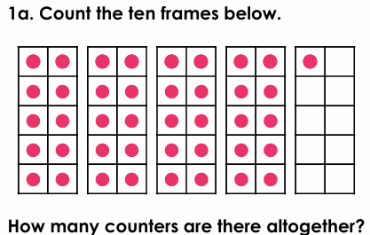
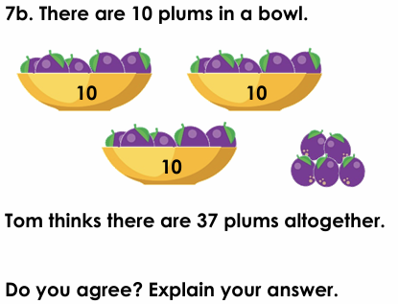
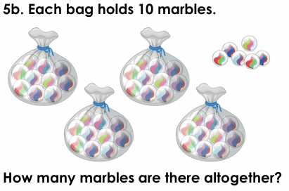
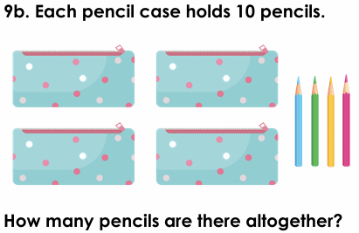

IT1
A
B
C
CC1

Slide 26
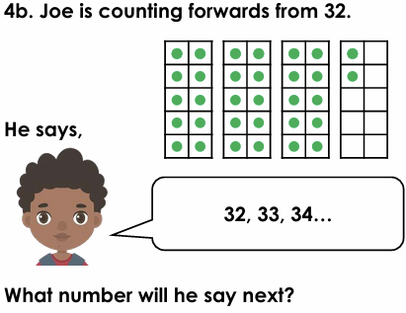
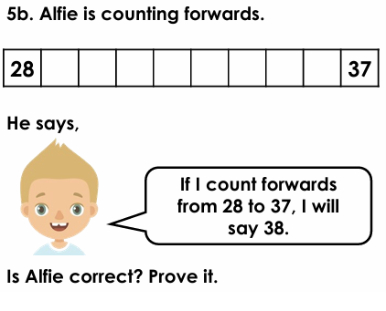
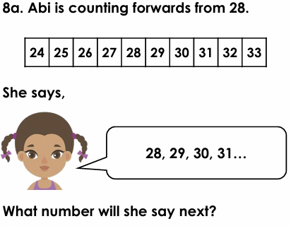

IT2
A
B
CC2

Slide 27
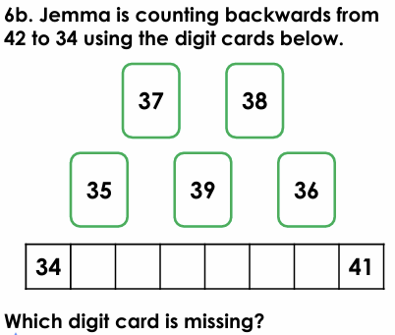

AFL

