Slide 1
Tuesday 8th September 2026
OLI: To explain what I would do if I were monarch for a day.
OSCI
I can choose something I would change or improve.
I can explain why I would make this change.
I can think about how my decision would help other people.

Slide 2




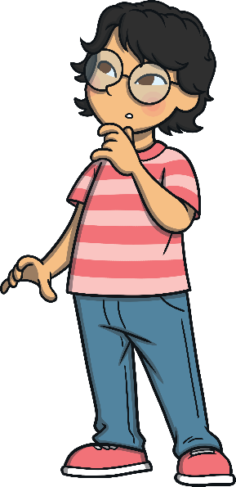
Royal Rules
What could
a king or queen
do to make
people happy?

Slide 3



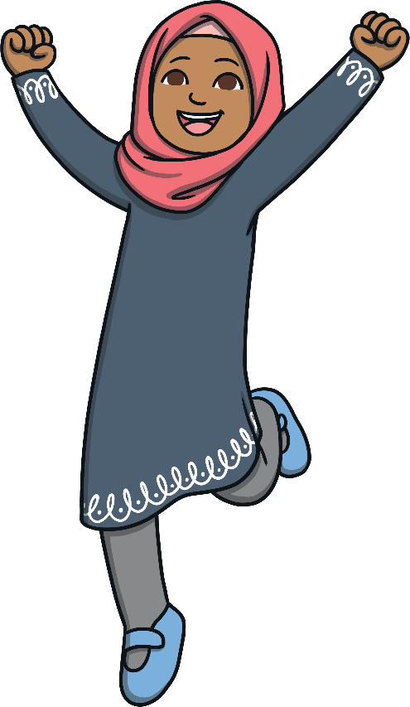
How can they help everyone have what they need?
Royal Rules
How can they make people smile or feel happy?
What could
a king or queen
do to make
people happy?
How can they show kindness to others?
How can they help people feel safe and cared for?

Slide 4


What would you do if you were the king or queen
of England?

Slide 5
If I were a king/queen I would…
I would help the people by…
I would make a rule that because…
What would you do if you were the king or queen of England?

Slide 6


