Slide 1
Tuesday 8th September 2026
OLI: To understand what a monarch is and find out about monarchs from the past.
OSCI:
I can explain what a monarch is.
I can find facts about a monarch.
I can use information to complete a monarch fact file.

Slide 2


What is a Monarch?
A monarch is a king or a queen who rules a country.
Usually, the crown is passed down inside the same royal family from parents to their children.
They live in grand castles and palaces!

Slide 3

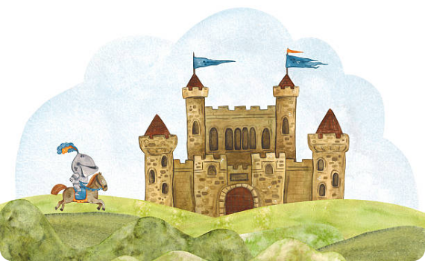
Castles and Palaces
Kings and queens don't live in ordinary houses! Throughout history, royal homes were built as strong fortresses called castles.
Would you want to live in a castle with a drawbridge and towers? Why or why not?

Slide 4






Pick a monarch to research, you can use one of the suggestions below or someone else.
Make a fact file about that monarch you can use the templates on this powerpoint as a guide.
King Charles III
Queen Elizabeth II
Someone Else!
Our current monarch who cares deeply about nature and the environment!
Our longest-reigning modern queen who loved corgis and horse riding.
Choose your own favourite king or queen from history to research.

Slide 5
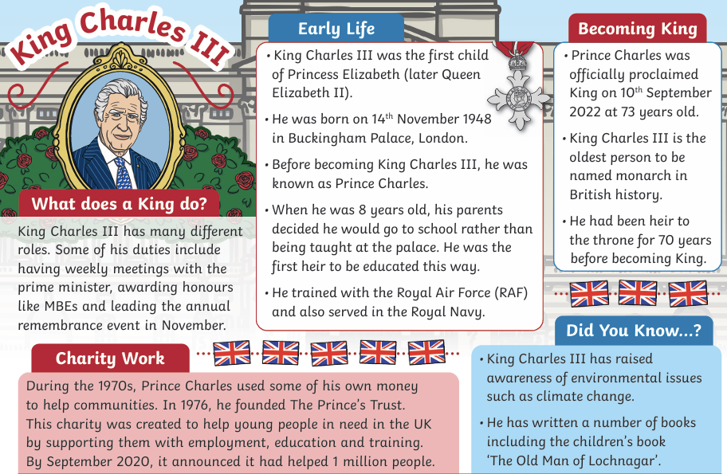

Slide 6
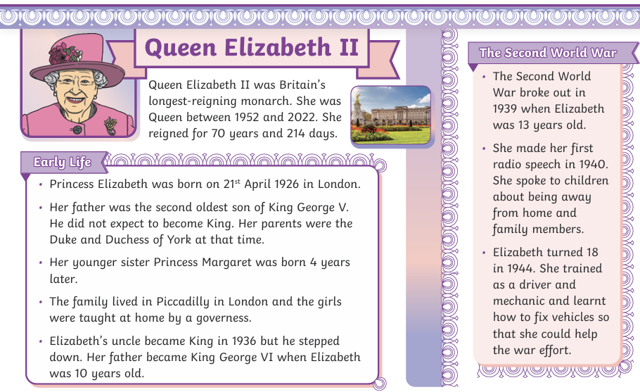

Slide 7
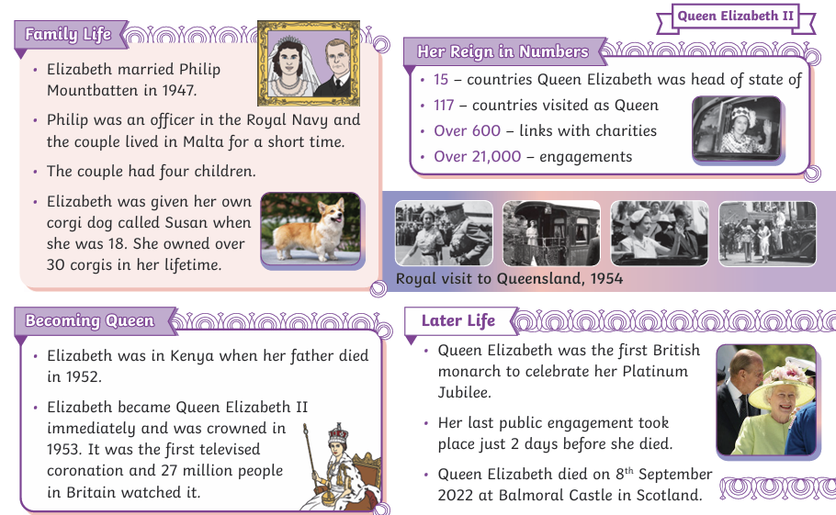

Slide 8
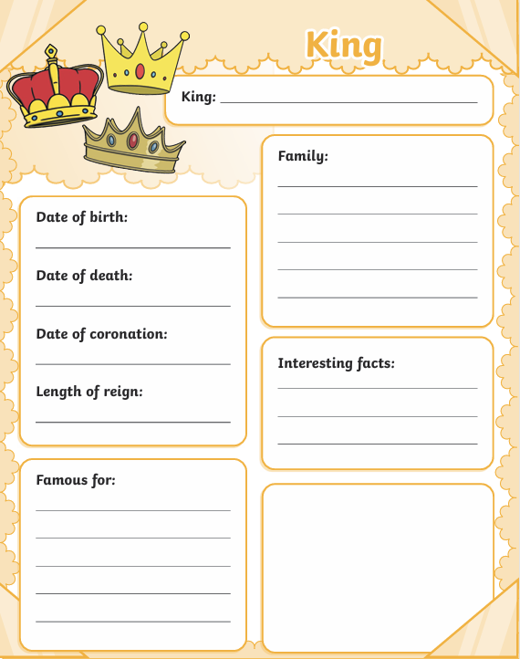
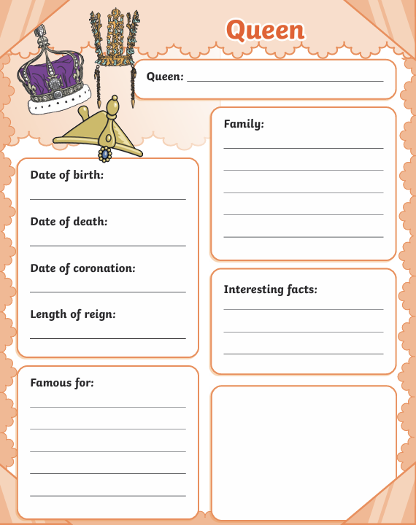

Slide 9

AFL
What's the most interesting fact you found out about your monarch?

