Slide 1
09/09/2026
OLI: To count forwards and backwards accurately from 20 to 50.
RTM
Complete the sequence
42,43,44,45,___,___,___
OSCI:
I can count forwards from 50 to 100.
I can count backwards from 100 to 50.
I can spot missing or incorrect numbers.

Slide 2
Let’s Get Warmed Up…
1. Find the missing number.
2. Complete the number track.
3. My number is more than 35 but less than 45. There is a 4 in the ten column. What is my number? Find 2 possible answers.
41 | 42 |  | 44 | 45 | 46
38 | 37 | 36 | 35 | 34

Slide 3
Let’s Get Warmed Up…
1. Find the missing number.
2. Complete the number track.
3. My number is more than 35 but less than 45. There is a 4 in the ten column. What is my number? Find 2 possible answers.
Various answers, for example: 43 and 44.
41 | 42 | 43 | 44 | 45 | 46
38 | 37 | 36 | 35 | 34 | 33 | 32 | 31 | 30 | 29

Slide 4
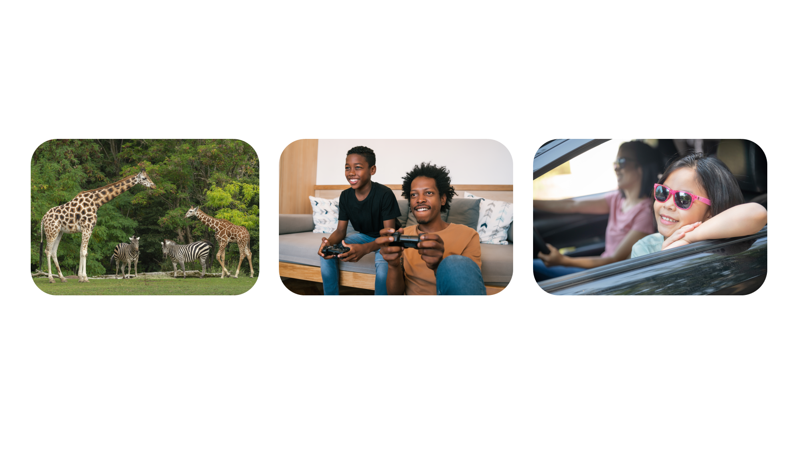
Maths in the Real World
Counting from 50 to 100 helps us read, compare and use bigger numbers every day. We use it when we count:
all the animals at the zoo
points scored in a game
the number of miles travelled in the car

Slide 5
Let’s Learn…
When we counted from 1 to 50, we spotted patterns in the numbers.
What patterns can you see?
1 | 2 | 3 | 4 | 5 | 6 | 7 | 8 | 9 | 10
11 | 12 | 13 | 14 | 15 | 16 | 17 | 18 | 19 | 20
21 | 22 | 23 | 24 | 25 | 26 | 27 | 28 | 29 | 30
31 | 32 | 33 | 34 | 35 | 36 | 37 | 38 | 39 | 40
41 | 42 | 43 | 44 | 45 | 46 | 47 | 48 | 49 | 50

Slide 6
Let’s Learn…
Let’s practise counting forwards from 50 to 100 out loud.
41 | 42 | 43 | 44 | 45 | 46 | 47 | 48 | 49 | 50
51 | 52 | 53 | 54 | 55 | 56 | 57 | 58 | 59 | 60
61 | 62 | 63 | 64 | 65 | 66 | 67 | 68 | 69 | 70
71 | 72 | 73 | 74 | 75 | 76 | 77 | 78 | 79 | 80
81 | 82 | 83 | 84 | 85 | 86 | 87 | 88 | 89 | 90
91 | 92 | 93 | 94 | 95 | 96 | 97 | 98 | 99 | 100

Slide 7
Let’s Learn…
We can use counting forwards to help us find missing numbers.
57 comes before the missing number. We need to count on one more from 57 to find the answer.
What is the missing number?
51 | 52 | 53 | 54 | 55 | 56 | 57 |  | 59 | 60

Slide 8
Let’s Practise…
Count forwards to find the missing numbers.
81 | 82 | 83 |  | 85 | 86 | 87 | 88 | 89 | 90
61 | 62 | 63 | 64 | 65 | 66 |  | 68 | 69 | 70

Slide 9
Let’s Practise…
Count forwards to find the missing numbers.
81 | 82 | 83 | 84 | 85 | 86 | 87 | 88 | 89 | 90
61 | 62 | 63 | 64 | 65 | 66 | 67 | 68 | 69 | 70

Slide 10
Let’s Learn…
Now let’s practise counting backwards from 100 to 50 out loud.
41 | 42 | 43 | 44 | 45 | 46 | 47 | 48 | 49 | 50
51 | 52 | 53 | 54 | 55 | 56 | 57 | 58 | 59 | 60
61 | 62 | 63 | 64 | 65 | 66 | 67 | 68 | 69 | 70
71 | 72 | 73 | 74 | 75 | 76 | 77 | 78 | 79 | 80
81 | 82 | 83 | 84 | 85 | 86 | 87 | 88 | 89 | 90
91 | 92 | 93 | 94 | 95 | 96 | 97 | 98 | 99 | 100

Slide 11
Let’s Learn…
We can also count backwards to help us find missing numbers.
76 comes after the missing number. We need to count back one from 76 to find the answer.
What is the missing number?
71 | 72 | 73 | 74 |  | 76 | 77 | 78 | 79 | 80

Slide 12
Let’s Practise…
Count backwards to find the missing numbers.
 | 72 | 73 | 74 | 75 | 76 | 77 | 78 | 79 | 80
91 | 92 | 93 | 94 | 95 | 96 | 97 |  | 99 | 100

Slide 13
Let’s Practise…
Count backwards to find the missing numbers.
71 | 72 | 73 | 74 | 75 | 76 | 77 | 78 | 79 | 80
91 | 92 | 93 | 94 | 95 | 96 | 97 | 98 | 99 | 100

Slide 14
Let’s Learn…
We can also use a 50 to 100 square to help us find what numbers come before or after a given number.
The number that comes after 56 is 57.
The number that comes before 62 is 61.
51 | 52 | 53 | 54 | 55 | 56 | 57 | 58 | 59 | 60
61 | 62 | 63 | 64 | 65 | 66 | 67 | 68 | 69 | 70
71 | 72 | 73 | 74 | 75 | 76 | 77 | 78 | 79 | 80
81 | 82 | 83 | 84 | 85 | 86 | 87 | 88 | 89 | 90
91 | 92 | 93 | 94 | 95 | 96 | 97 | 98 | 99 | 100

Slide 15
Let’s Practise…
Complete the sentences.
The number that comes after 95 is .
The number that comes before 86 is .
51 | 52 | 53 | 54 | 55 | 56 | 57 | 58 | 59 | 60
61 | 62 | 63 | 64 | 65 | 66 | 67 | 68 | 69 | 70
71 | 72 | 73 | 74 | 75 | 76 | 77 | 78 | 79 | 80
81 | 82 | 83 | 84 | 85 | 86 | 87 | 88 | 89 | 90
91 | 92 | 93 | 94 | 95 | 96 | 97 | 98 | 99 | 100

Slide 16
Let’s Practise…
Complete the sentences.
The number that comes after 95 is .
The number that comes before 86 is .
51 | 52 | 53 | 54 | 55 | 56 | 57 | 58 | 59 | 60
61 | 62 | 63 | 64 | 65 | 66 | 67 | 68 | 69 | 70
71 | 72 | 73 | 74 | 75 | 76 | 77 | 78 | 79 | 80
81 | 82 | 83 | 84 | 85 | 86 | 87 | 88 | 89 | 90
91 | 92 | 93 | 94 | 95 | 96 | 97 | 98 | 99 | 100
96
85

Slide 17
Let’s Learn…
When counting forwards or backwards, we might count across ten.
The tens digit and one digit will change.
The number that comes after 59 is 60.
The number that comes before 80 is 79.
51 | 52 | 53 | 54 | 55 | 56 | 57 | 58 | 59 | 60
61 | 62 | 63 | 64 | 65 | 66 | 67 | 68 | 69 | 70
71 | 72 | 73 | 74 | 75 | 76 | 77 | 78 | 79 | 80
81 | 82 | 83 | 84 | 85 | 86 | 87 | 88 | 89 | 90
91 | 92 | 93 | 94 | 95 | 96 | 97 | 98 | 99 | 100

Slide 18
Let’s Practise…
Complete the sentences.
The number that comes after 79 is .
The number that comes before 100 is .
51 | 52 | 53 | 54 | 55 | 56 | 57 | 58 | 59 | 60
61 | 62 | 63 | 64 | 65 | 66 | 67 | 68 | 69 | 70
71 | 72 | 73 | 74 | 75 | 76 | 77 | 78 | 79 | 80
81 | 82 | 83 | 84 | 85 | 86 | 87 | 88 | 89 | 90
91 | 92 | 93 | 94 | 95 | 96 | 97 | 98 | 99 | 100

Slide 19
Let’s Practise…
Complete the sentences.
The number that comes after 79 is .
The number that comes before 100 is .
51 | 52 | 53 | 54 | 55 | 56 | 57 | 58 | 59 | 60
61 | 62 | 63 | 64 | 65 | 66 | 67 | 68 | 69 | 70
71 | 72 | 73 | 74 | 75 | 76 | 77 | 78 | 79 | 80
81 | 82 | 83 | 84 | 85 | 86 | 87 | 88 | 89 | 90
91 | 92 | 93 | 94 | 95 | 96 | 97 | 98 | 99 | 100
80
99

Slide 20

Let’s Reason…
George is counting.
If I count from 50 to 80, I will say 60.
Is George correct? Explain how you know.
George is correct/incorrect because…

Slide 21
Let’s Reason…
George is counting.
If I count from 50 to 80, I will say 60.
Is George correct? Explain how you know.
George is correct because 60 comes after 50 and before 80.

Slide 22

Let’s Problem Solve…
Emi is counting backwards.
What numbers will Emi say that have 7 ones?
Find 2 possible answers.
I am counting from 90 to 60.

Slide 23
Let’s Problem Solve…
Emi is counting backwards.
What numbers will Emi say that have 7 ones?
Find 2 possible answers.
Various answers, for example: 77 and 67.
I am counting from 90 to 60.

Slide 24
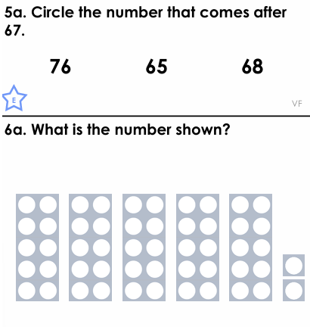
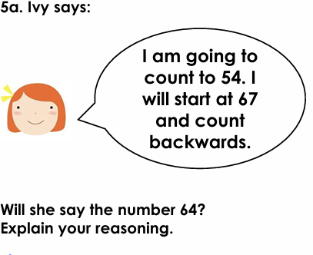
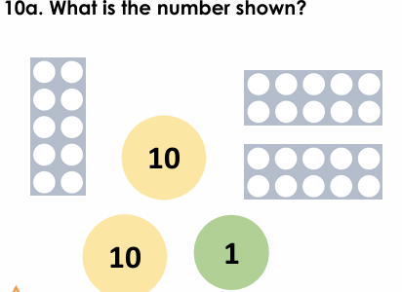



IT1
A
B
C
CC1

Slide 25
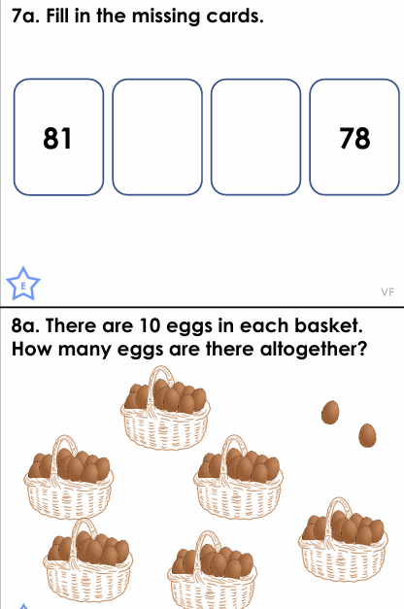
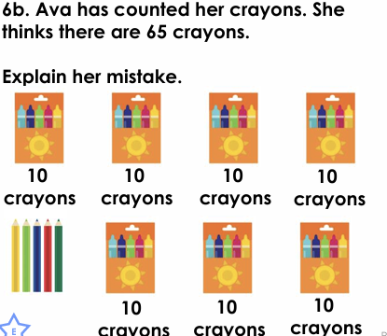




IT2
A
B
CC2

Slide 26
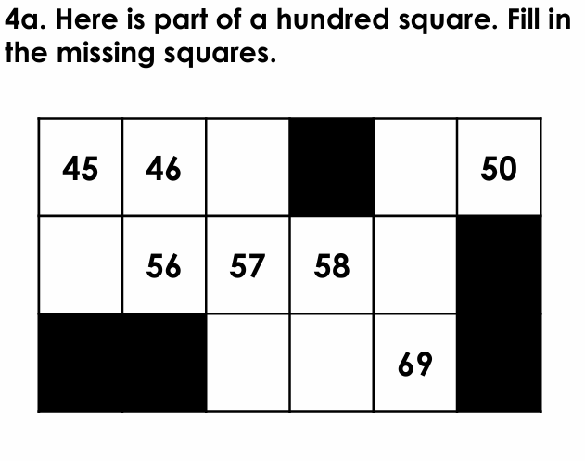

AFL

