Slide 1
Wednesday 9th September 2026
OLI: To understand what a castle is and create a fact file about one.
OSCI:
I can explain what a castle is.
I can find facts about a castle
I can use information to complete a castle fact file.

Slide 2

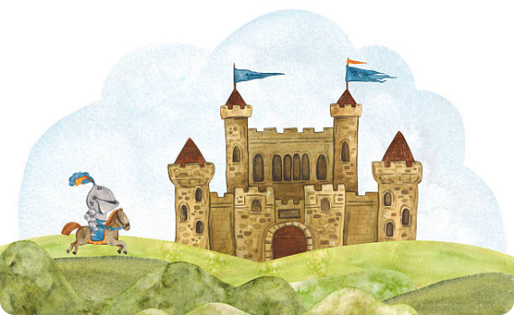
What is a Castle?
A castle is a large, strong building made long ago to protect kings, queens, and knights from danger.
They usually have thick stone walls, high towers, and a deep ditch called a moat filled with water!
People crossed a heavy wooden drawbridge to get inside.

Slide 3
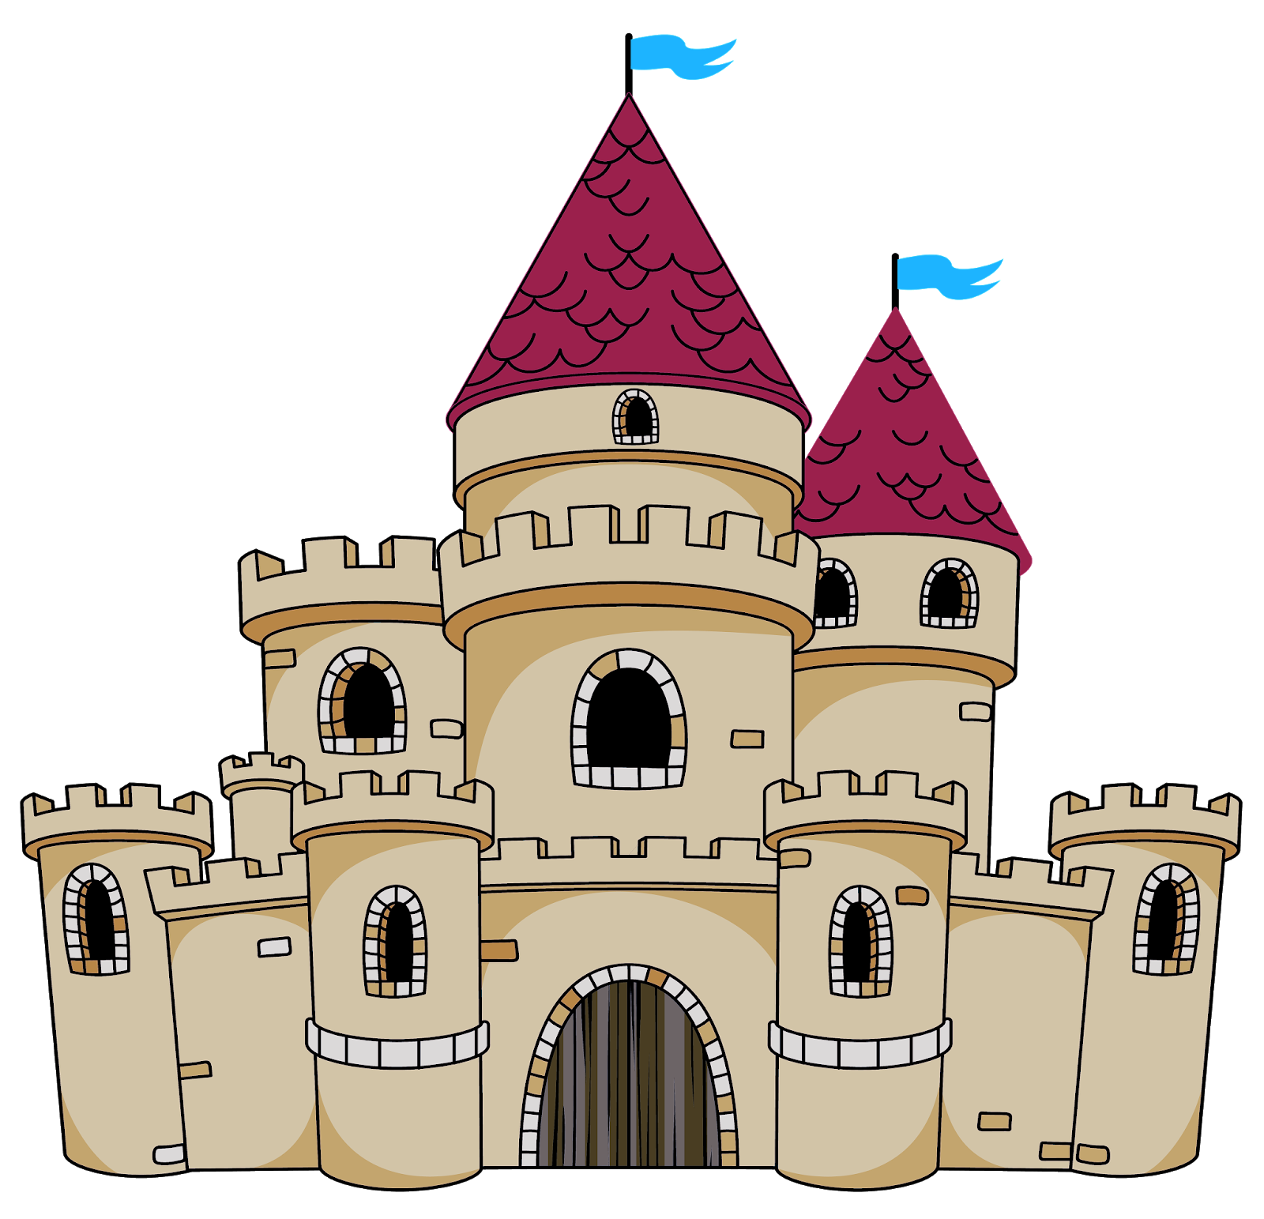
Super Castle Features
Castles weren't just homes—they were giant puzzles built for defense!
Key parts to spot:
The Keep: The tallest and safest tower in the middle.
Battlements: Notched walls where guards stood watch.
This Photo by Unknown Author is licensed under CC BY-NC-ND

Slide 4






Choose Your Castle
Which famous castle will you investigate for your fact-file today?
Warwick Castle
Leeds Castle
Your Own Choice!
A mighty medieval castle where kings, queens and warriors once lived, fought and celebrated!
A beautiful castle surrounded by water where queens once lived and royal guests were welcomed!
Choose any famous castle you like from a book, movie, or holiday trip to research.

Slide 5
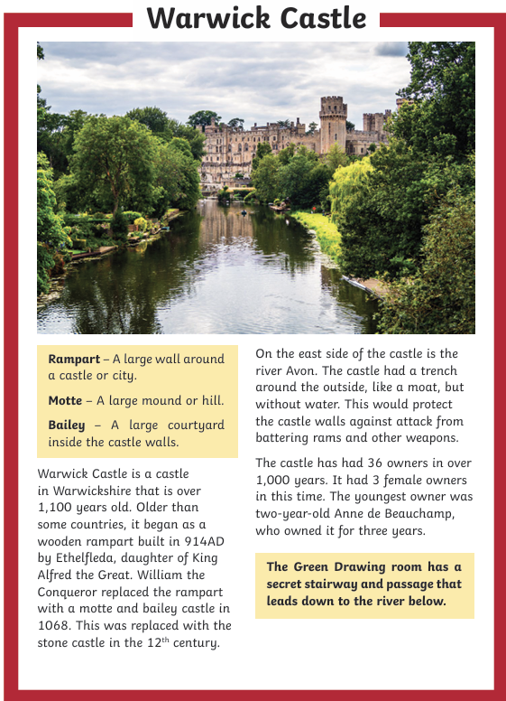
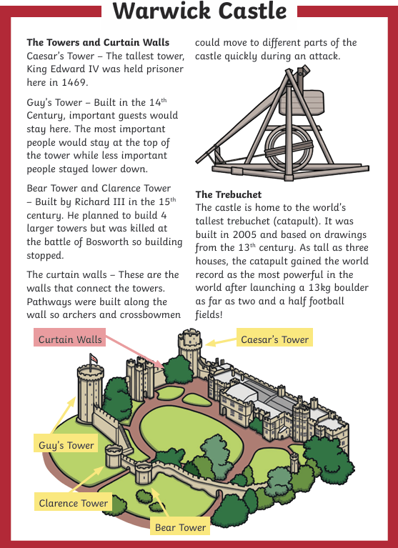

Slide 6
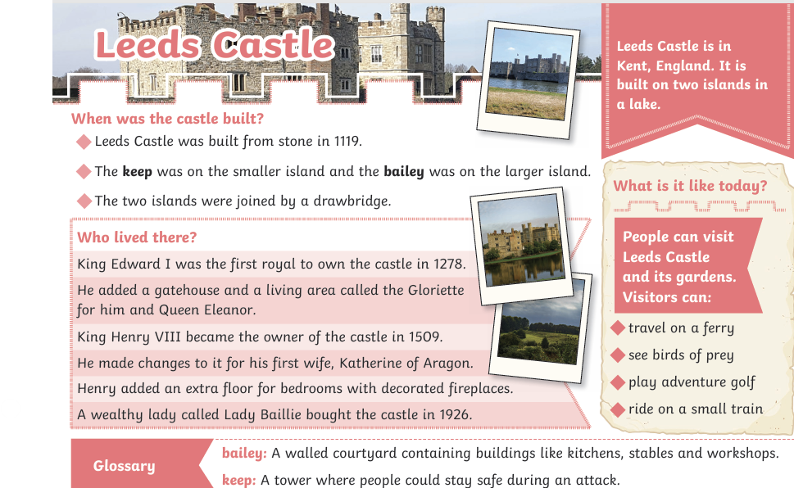

Slide 7
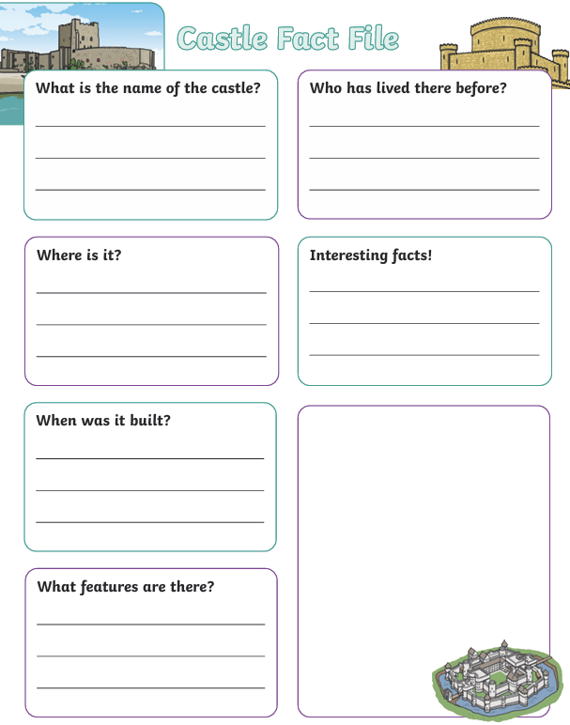

Slide 8

AFL
What's the most interesting fact you found out about your castle?

