Slide 1


Slide 2
Wednesday 9th September 2026
OLI: To apply for a job in a castle.
OSCI
I can choose a job I would like to do in a castle.
I can describe the skills I would need for the job.
I can explain why I would be good at the job.

Slide 3

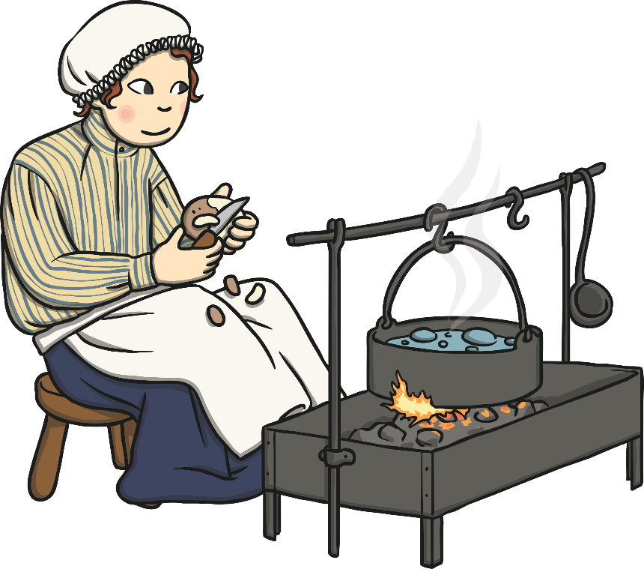
Cook
Duties:
To prepare meals for the family and to keep the kitchen clean.
Must be:
An organised individual who is clean, tidy and efficient.
To apply, complete an application form.

Slide 4
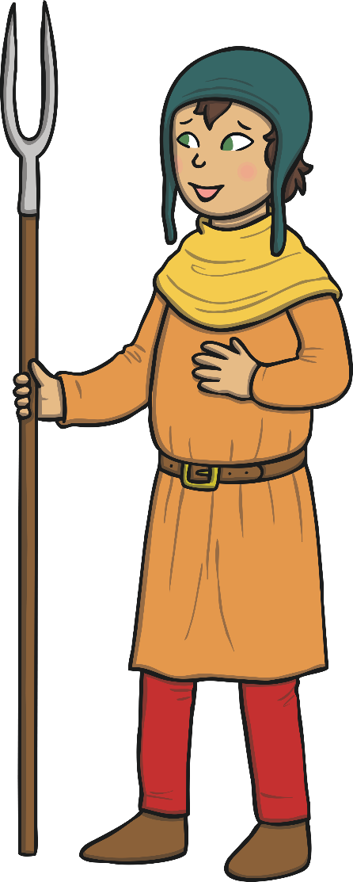
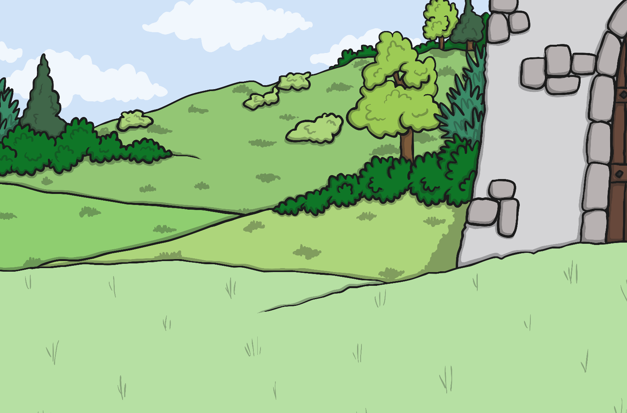

Gardener
Duties:
To ensure the castle gardens are maintained as well as keeping the walls free from ivy.
Must be:
A hardworking individual who is passionate about safety.
To apply, complete an application form.

Slide 5

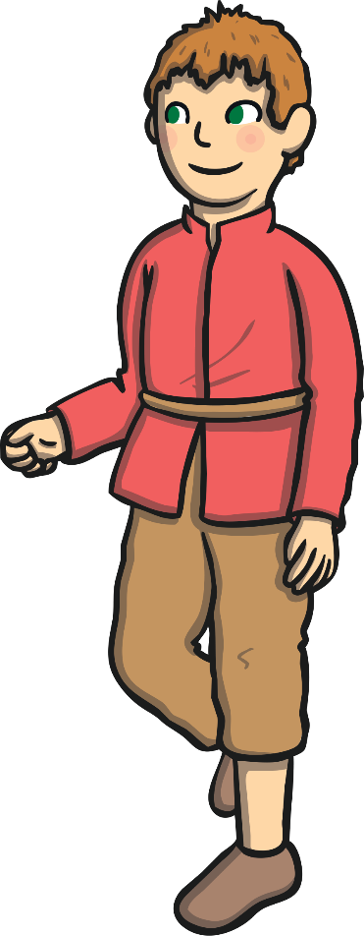



Candlemaker
Duties:
To make candles for use through the entire castle.
Must be:
A skilled craftsman who is able to work efficiently.
To apply, complete an application form.

Slide 6
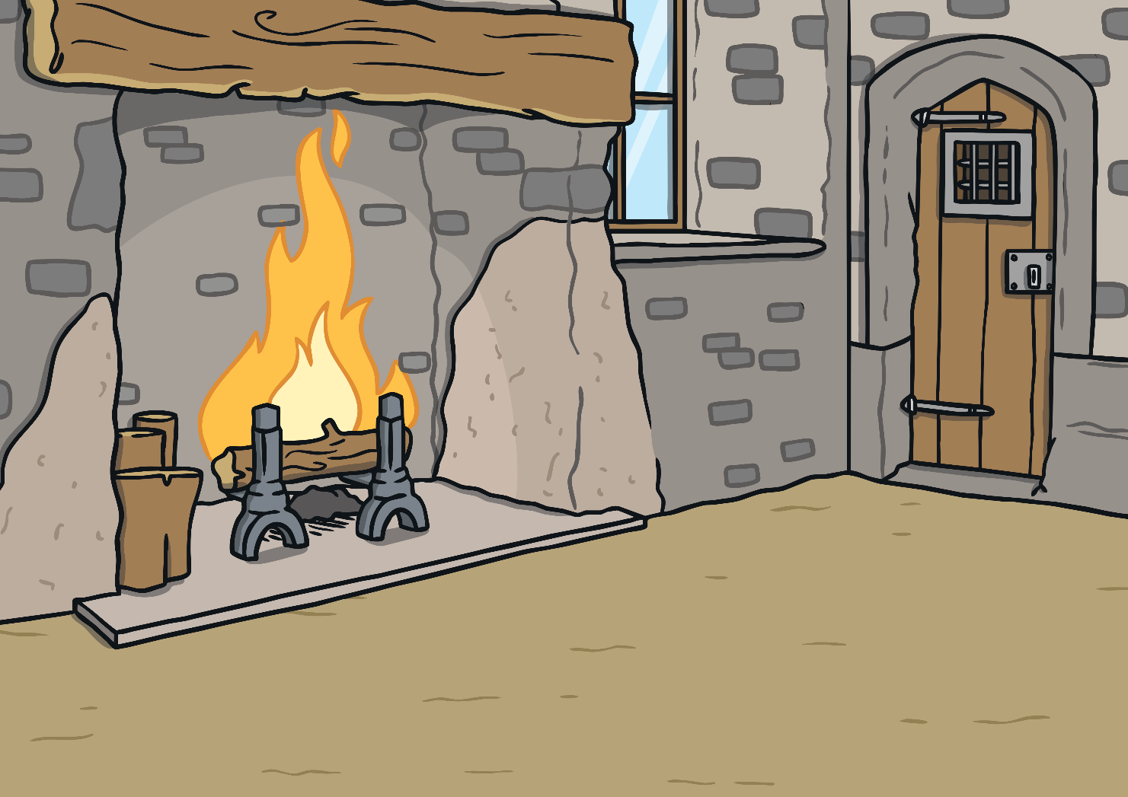
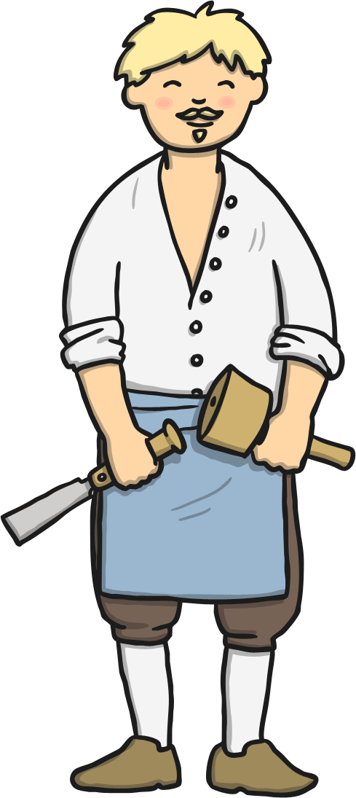
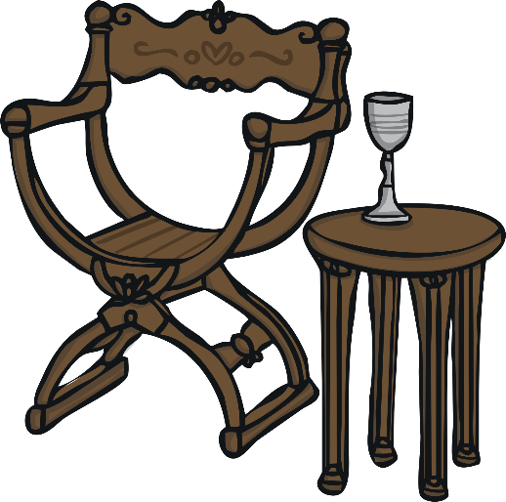

Carpenter
Duties:
To craft things out of wood for use throughout the castle.
Must be:
A highly skilled tradesman who can use tools competently and safely.
To apply, complete an application form.

Slide 7
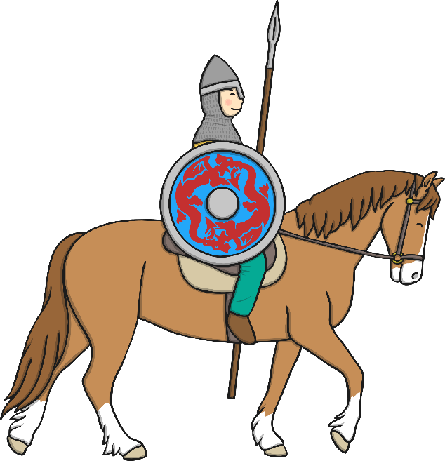
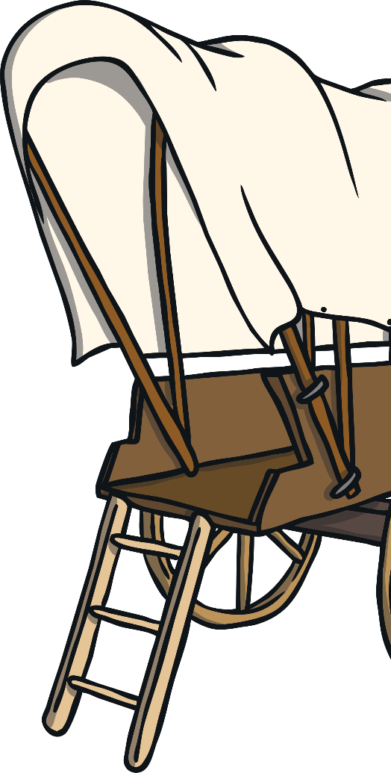
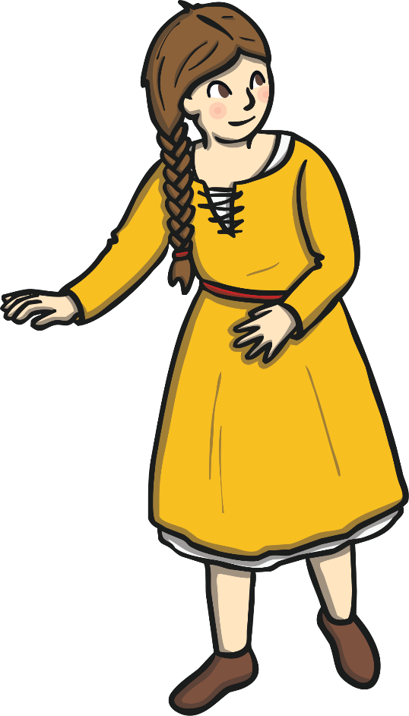
Marshal
Duties:
To be responsible for the household’s horses, carts and wagons as well as the transportation of goods.
Must be:
An organised individual
who is punctual and
hard-working.
To apply, complete an application form.

Slide 8
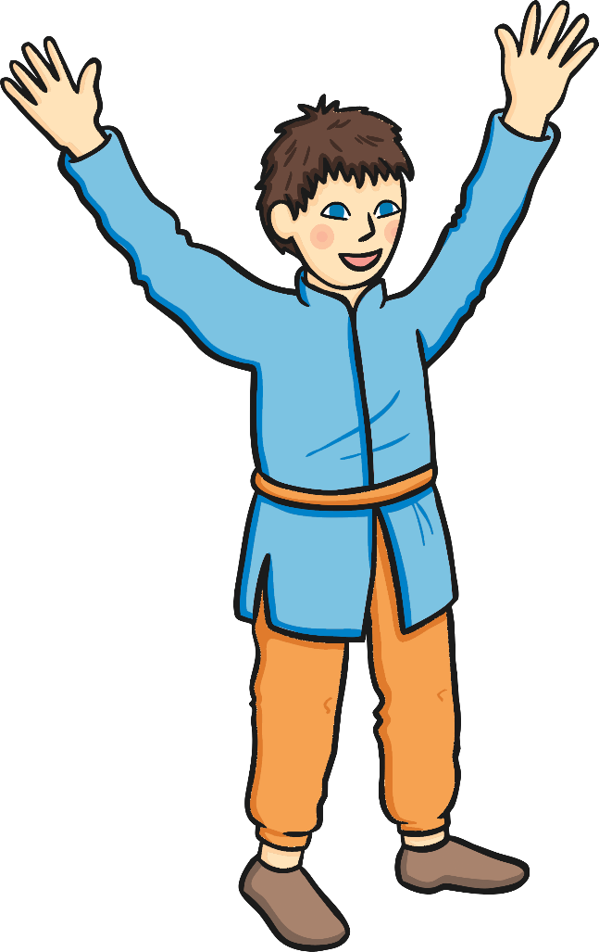

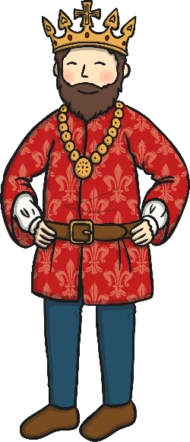
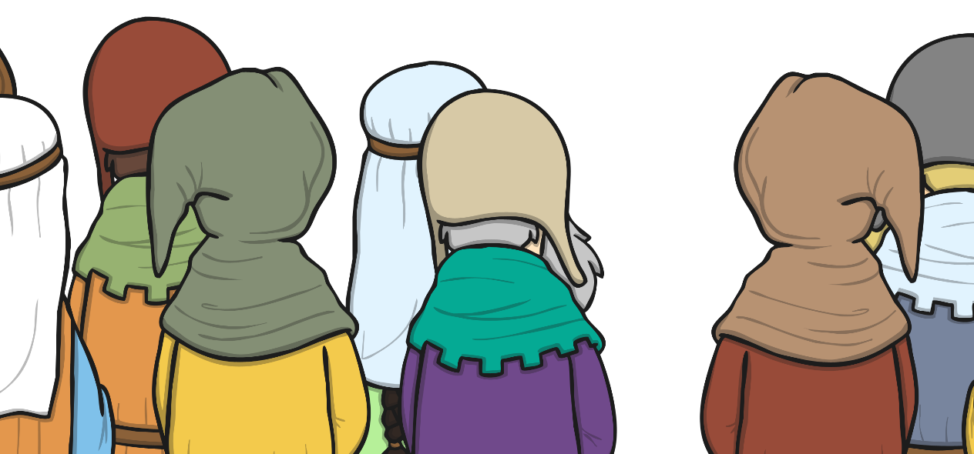
Herald
Duties:
To announce on behalf of the King to the public.
Must be:
A confident individual who is able to speak in front of crowds.
To apply, complete an application form.

Slide 9
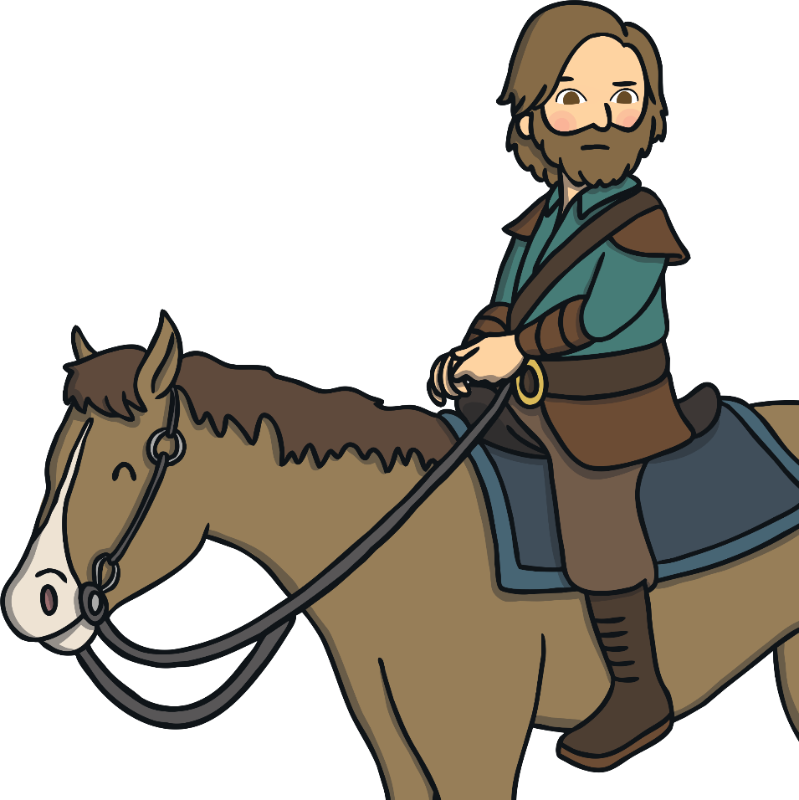

Messenger
Duties:
To carry information to others on behalf of a Lord.
Must be:
A trustworthy individual who is reliable, punctual and efficient.
To apply, complete an application form.

Slide 10
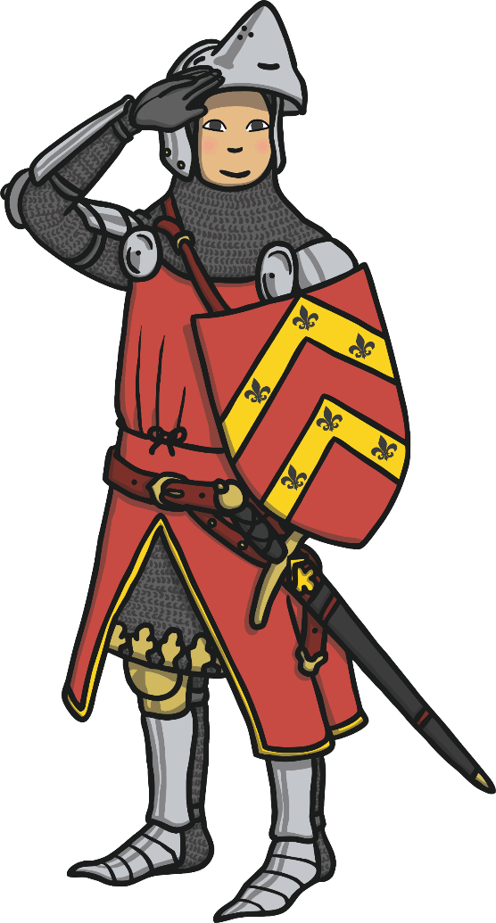
Watchman
Duties:
To be responsible for castle security, ensuring the castle is safe.
Must be:
A trustworthy individual who is hard-working and punctual.
To apply, complete an application form.

Slide 11


