Slide 1
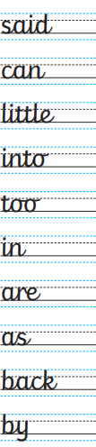

Thursday 15th October 2026
Literacy
HWP
CC: Write sentences with the words

Slide 2


Slide 3
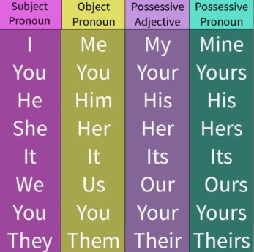

CS: 15.10.2026 - Pronouns
Write a sentence with a pronoun

Slide 4

Literacy Thursday 15th October 2026
OLI: To write simple sentences.
OSCI:
I can use common exception words
I can include full stops correctly
I can include finger spaces correctly
I can include capital letters correctly

Slide 5
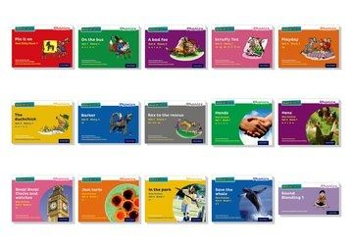

TTYP
Look at the Read write Inc book
What can you see on the front cover?

Slide 6
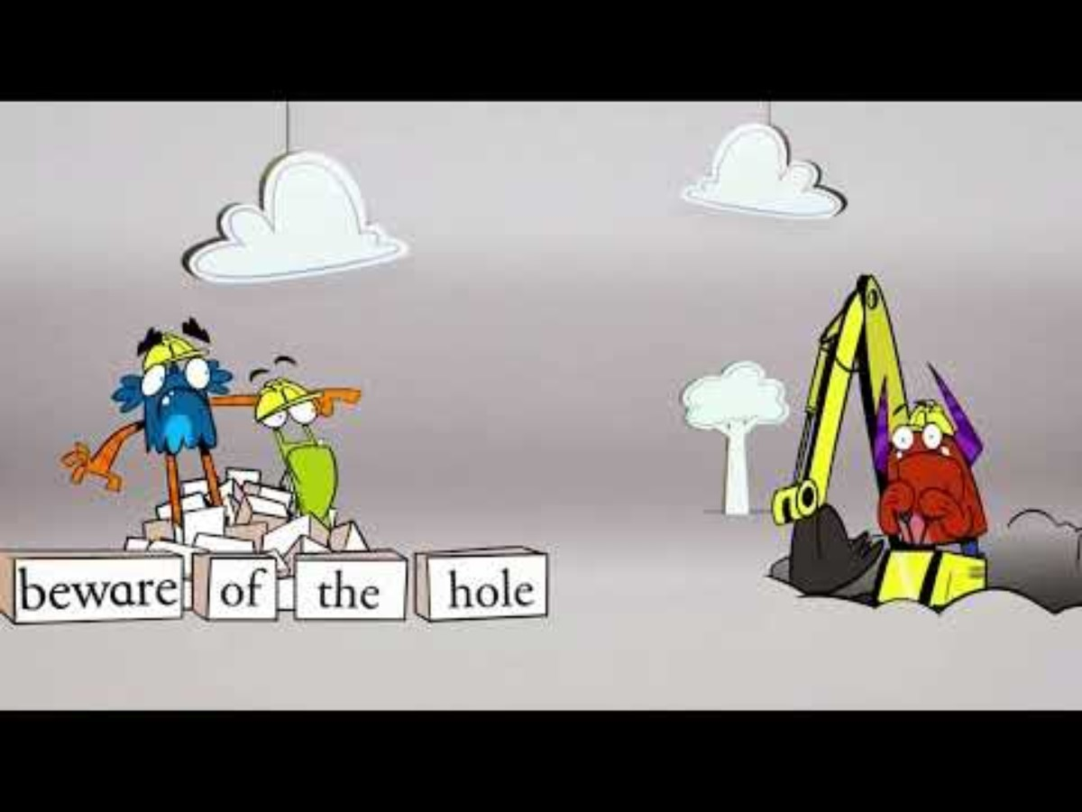
IT1: Write a list of what you can see on the front cover of your RWI book.
IT2. Now put the words into sentences
Notes:
Read chapter one and stop to discuss when author describe Lilly's personality and appearance. Children to create a table in their books describing Lilly.

Slide 7


AFL
Underline or adds adjective to your sentence.
I have been shining at …….
I can ARISE further by …….
SA
I can use common exception words​
I can include full stops correctly​
I can include adjectives
I can include capital letters correctly​

Slide 8
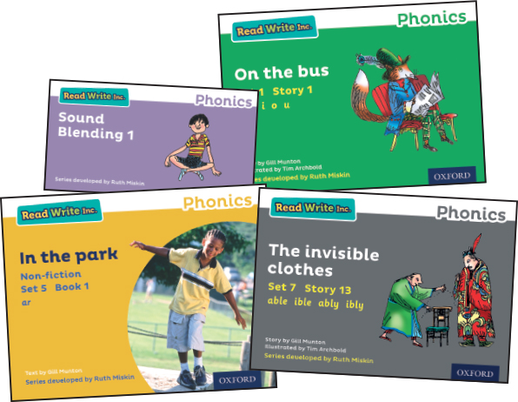
Read your RWI book

Slide 9


Slide 10

Comprehension
Verbally answer the questions at the back.

Slide 11


